Slide 1
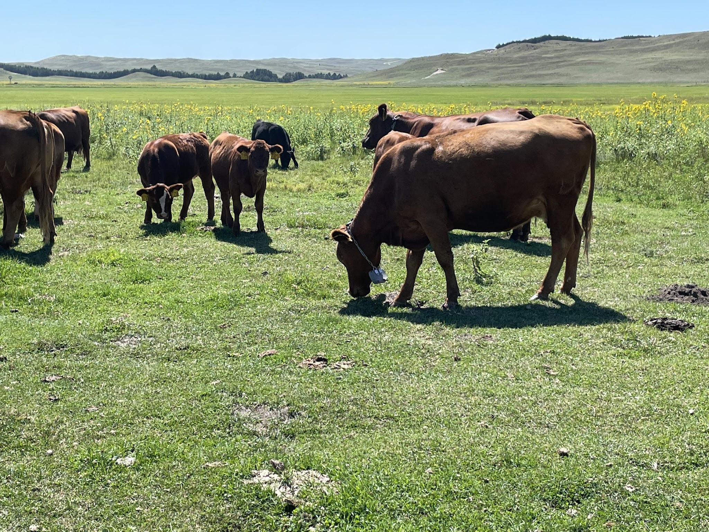
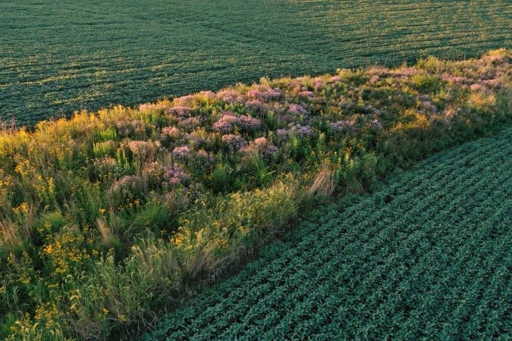



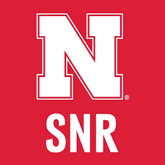
“Finding the Balance” for
Conservation in Working Landscapes
Andrew Little, Ph.D.
Assistant Professor of Landscape Ecology and Habitat Management
School of Natural Resources
University of Nebraska-Lincoln
Follow us @awesmlab

Slide 2
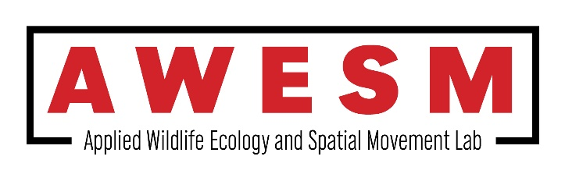
Outline
1) A Little About the Lab…
2) Challenges in the Midwestern Landscapes
    3) Precision Conservation
    4) So, Where Do We Go From Here?

Slide 3

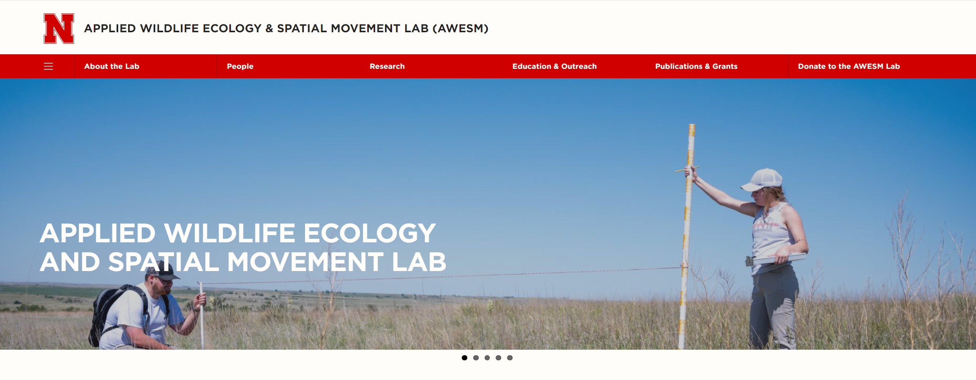


Check Out Our Lab!
Our mission is to provide applicable science to help landowners and management agencies balance the needs of agriculturally-dominated landscapes and create healthy, robust ecosystems.
Follow our lab @AWESMLab

Slide 4
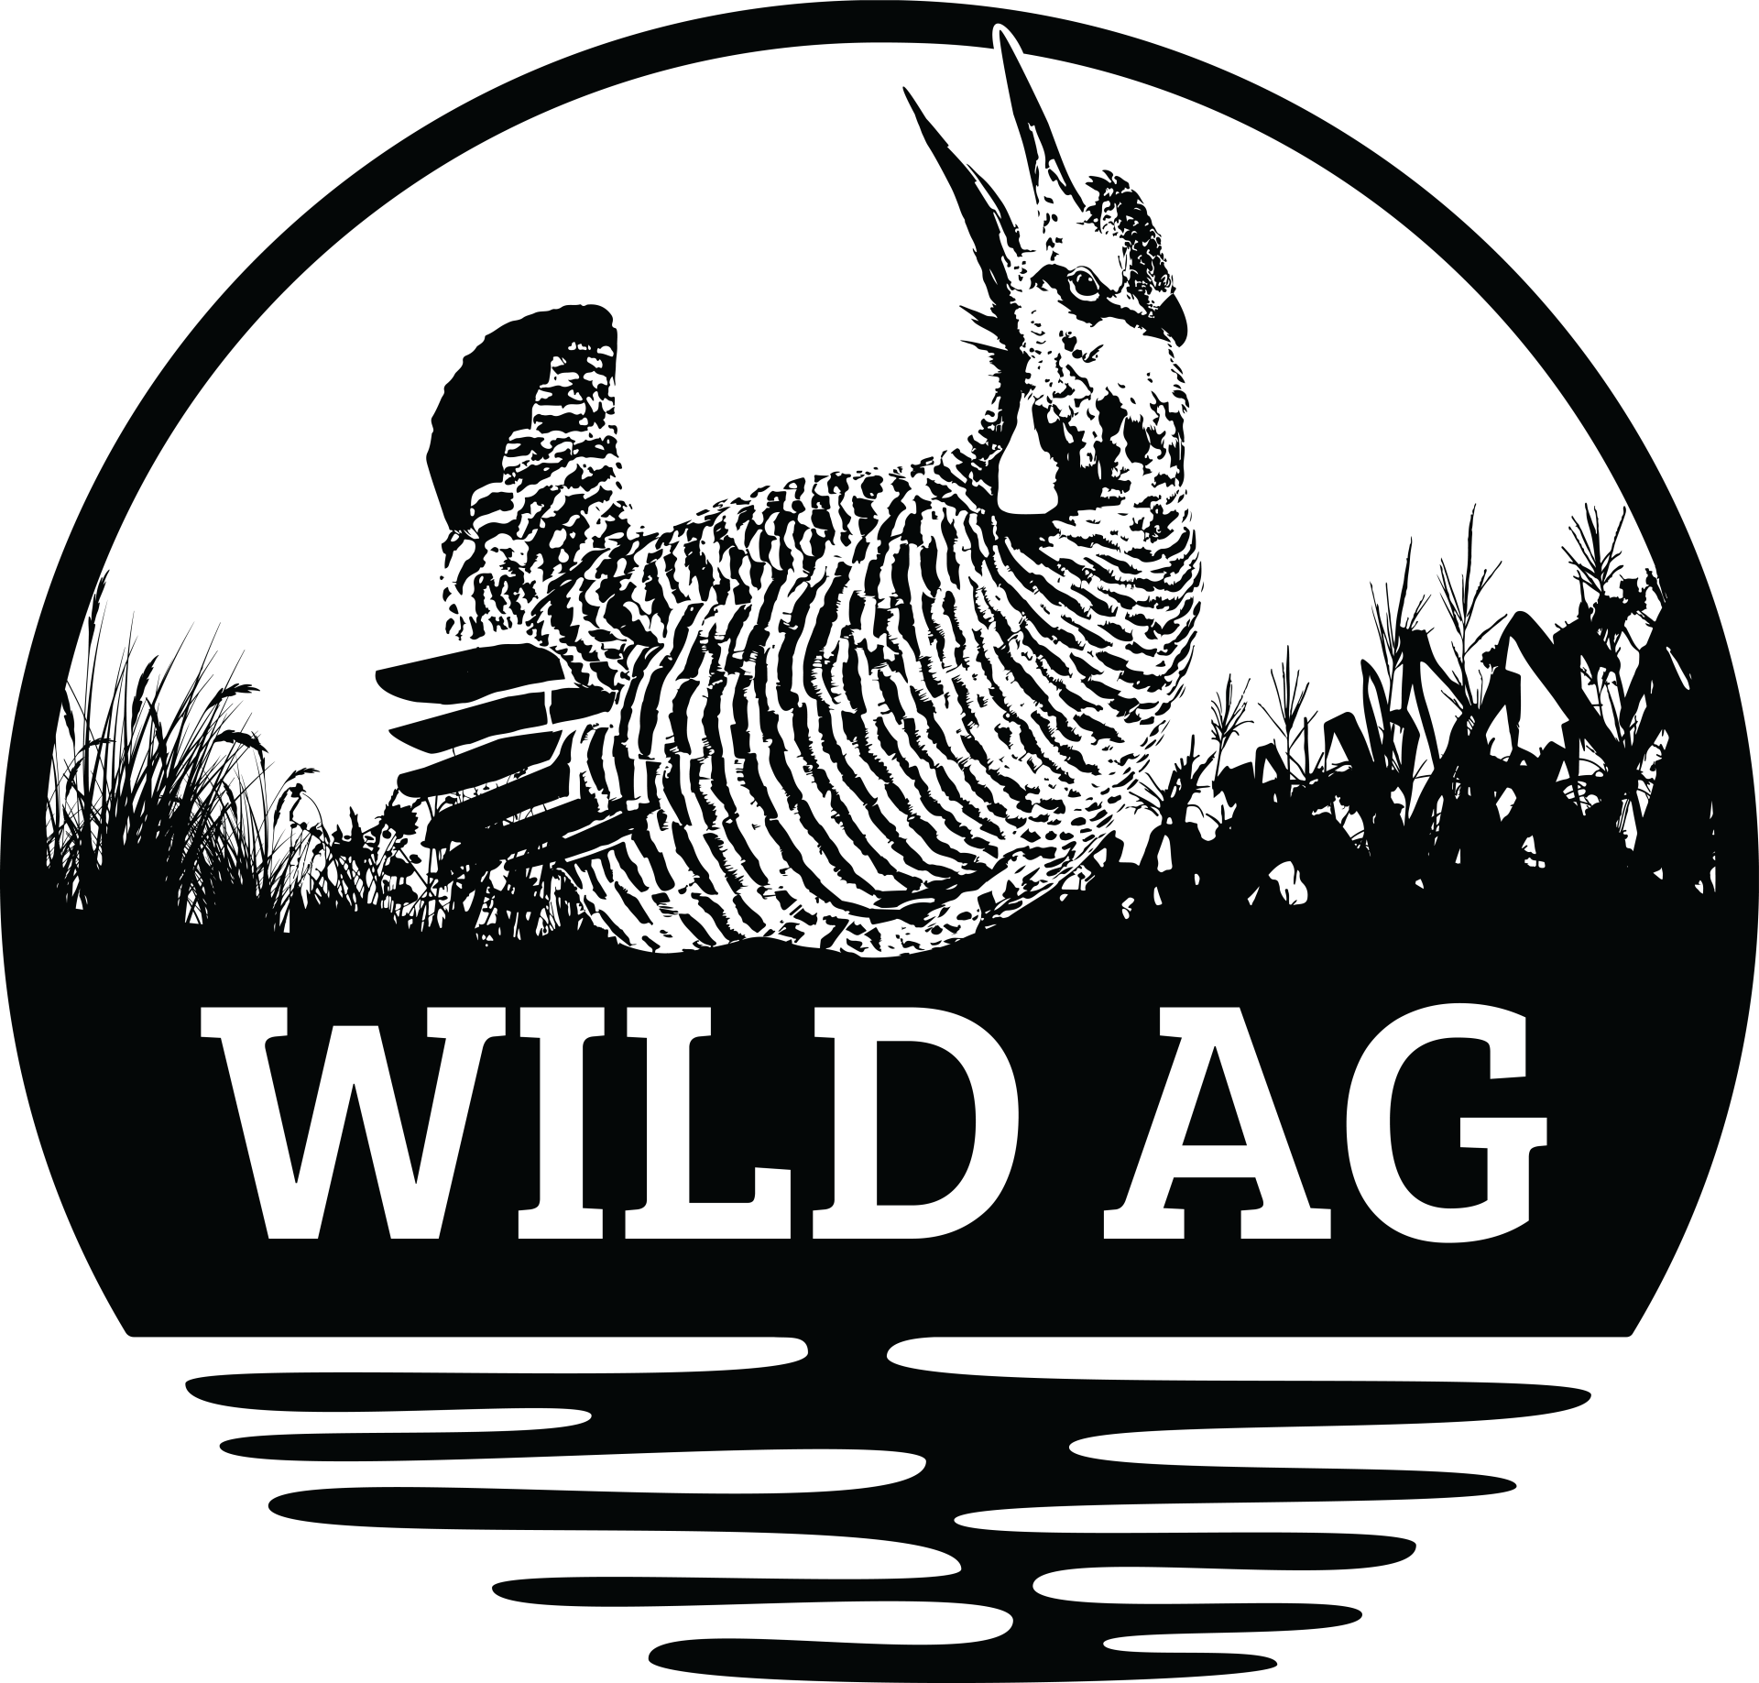
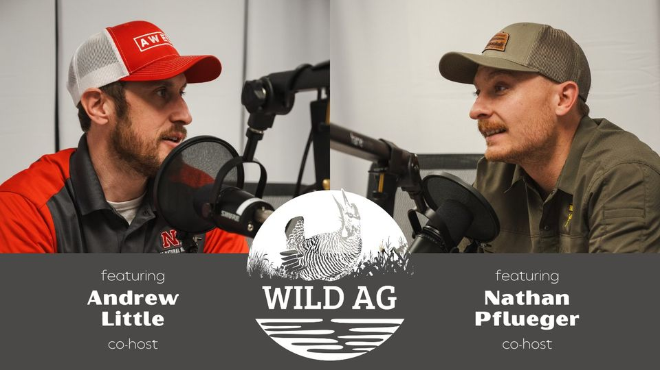
Check Out the WildAg Podcast!
Episode Themes: Soil – Water – Wildlife

Slide 5
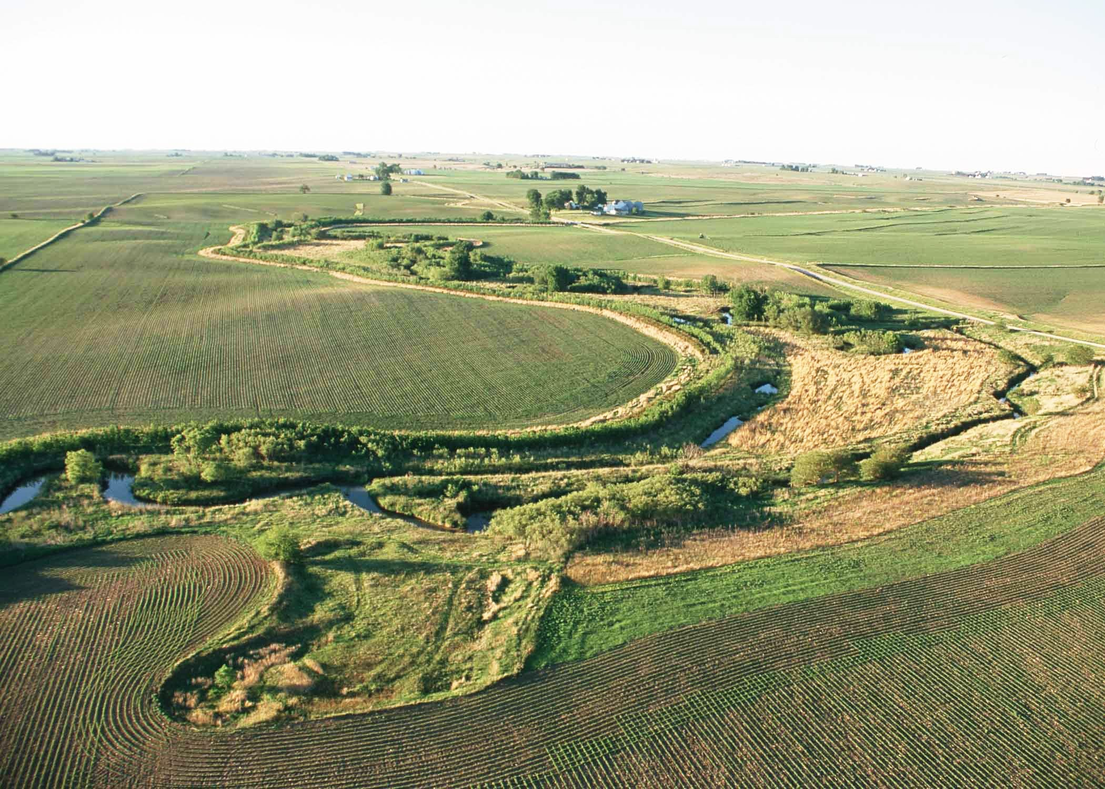
A Changing Midwestern USA Landscape:
Natural Resource Challenges in the 21st Century
Credit: Lynn Betts, USDA

Slide 6
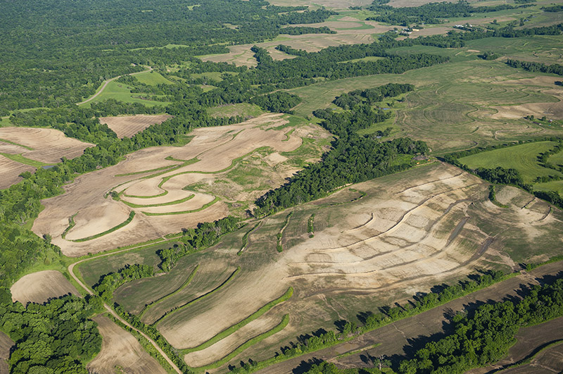
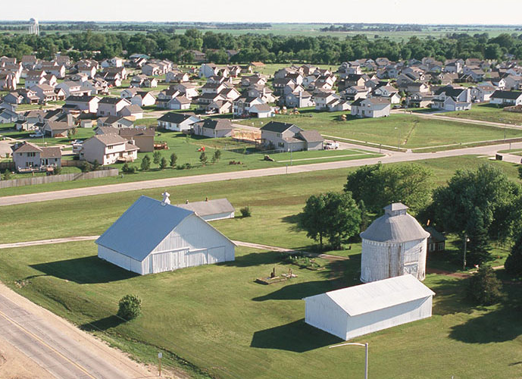
Challenges: Habitat Loss and Degradation
Credit: NEBRASKAland Magazine/Nebraska Game and Parks Commission, and Lynn Betts USDA

Slide 7
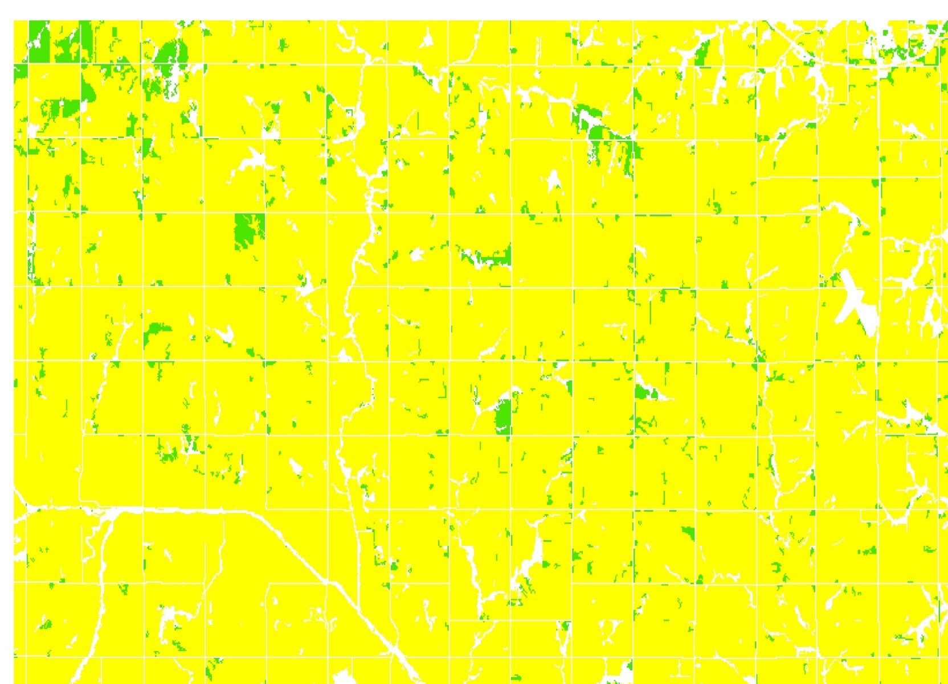
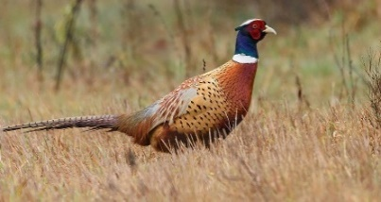
Challenges: Landscape Fragmentation

Slide 8
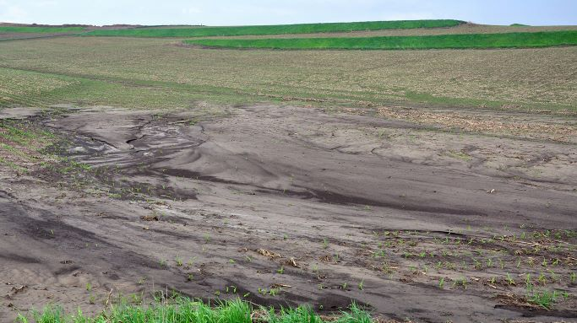
Challenges: Soil Erosion
Credit: USDA-NRCS

Slide 9
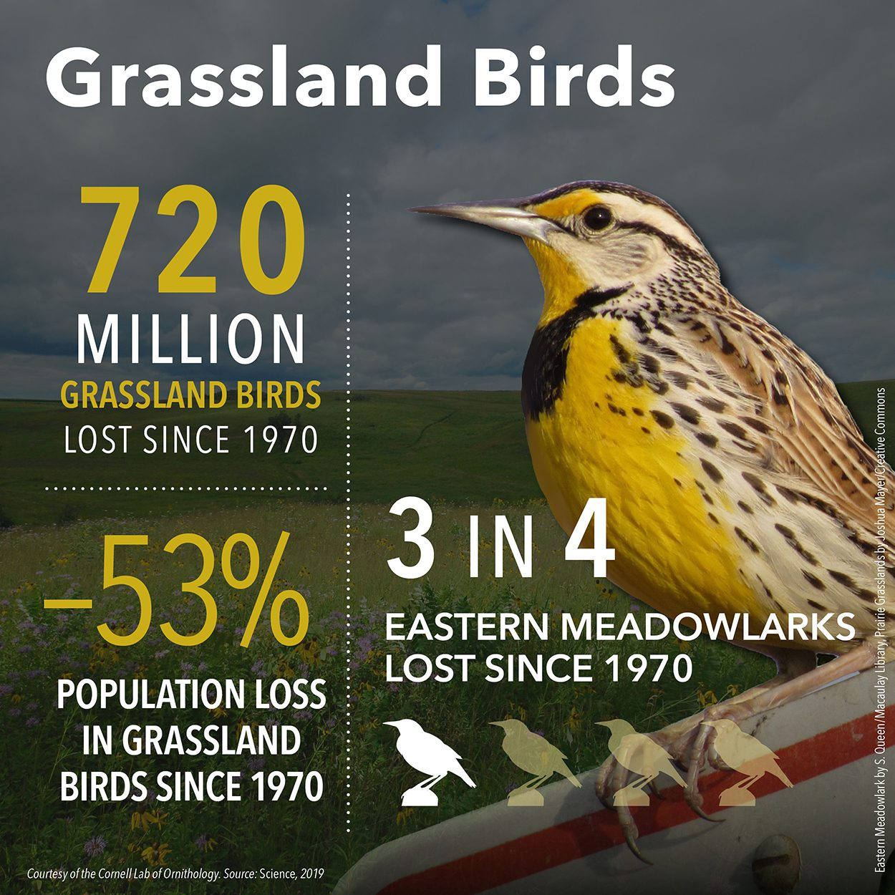

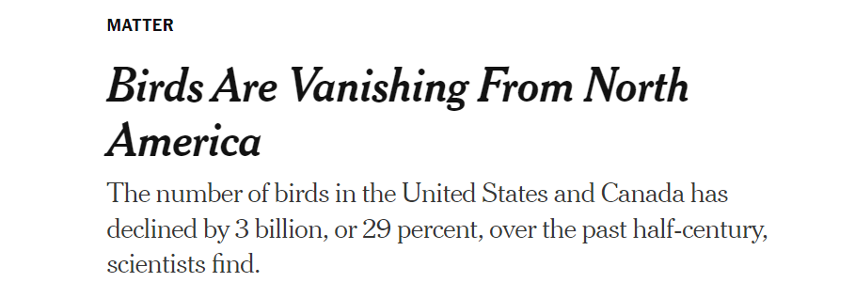
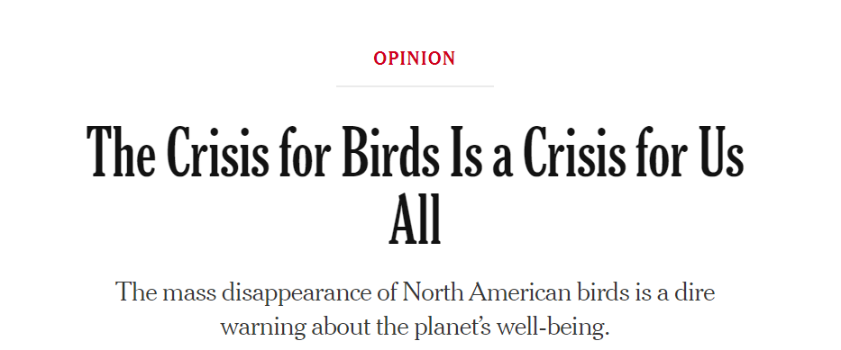
Challenges: Declining Wildlife Populations

Slide 10
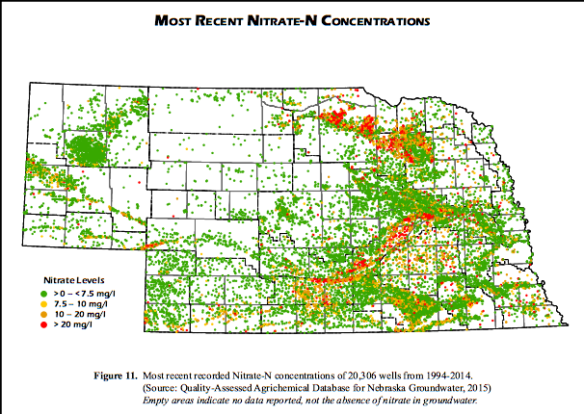
Challenges: Water Quality Issues

Slide 11
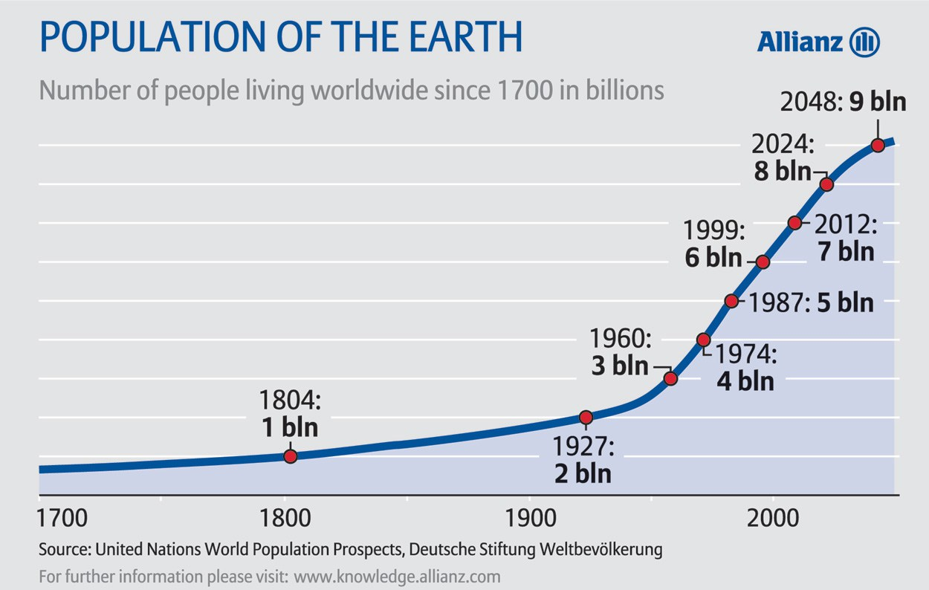
Challenges: Growing World Population
Expected 9.7 billion people
by 2050 will require
50% in food production

Slide 12
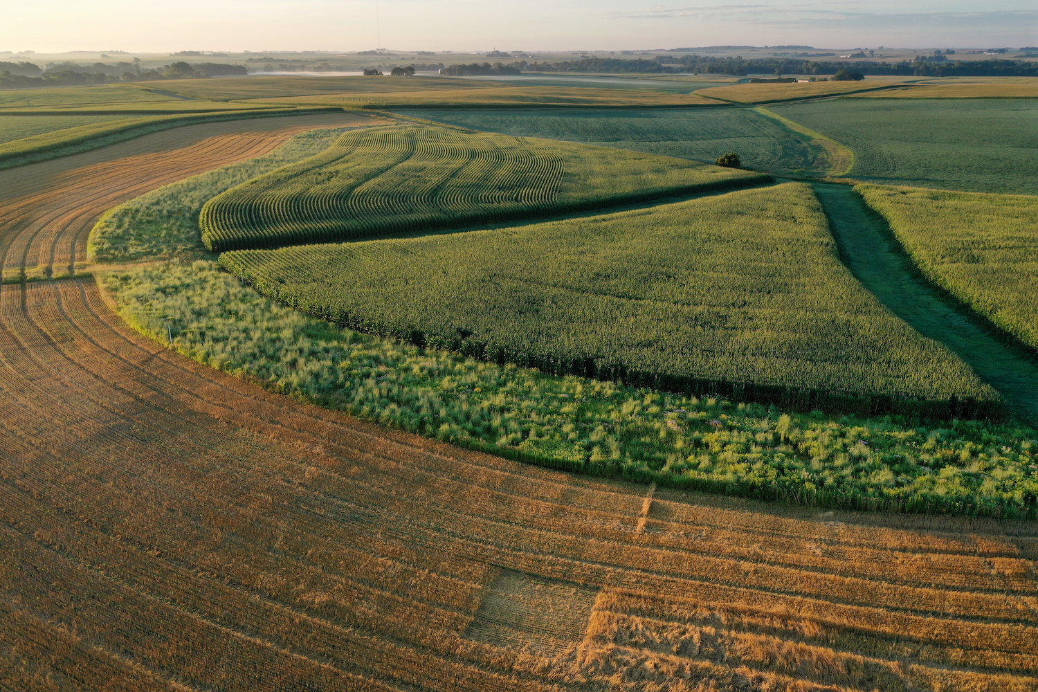
We Must “Find the Balance”
Between Agriculture and Conservation!
Credit: Omar de Kok-Mercado/STRIPS

Slide 13
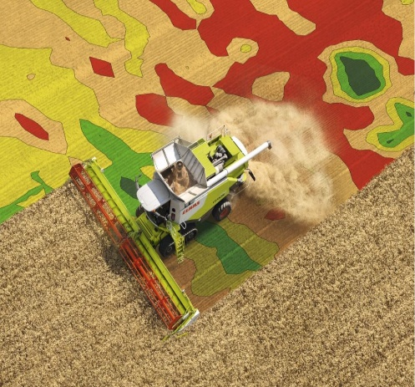
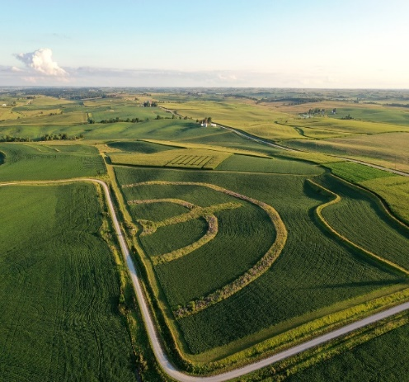
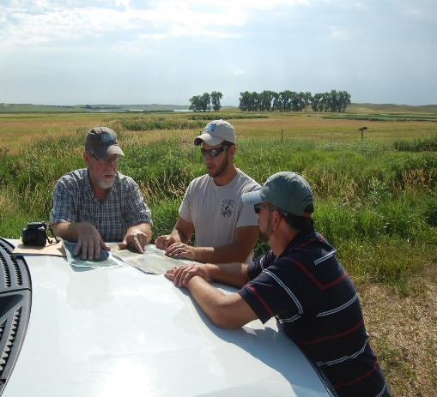
Finding the Balance
Between Agriculture and Conservation!
Ag Technology
Human Dimensions
Conservation
Credit: http://www.farmtechsolutions.ie/, Prairie Strips, USFWS

Slide 14
Leveraging Ag Technology to Strategically Target Conservation

Slide 15
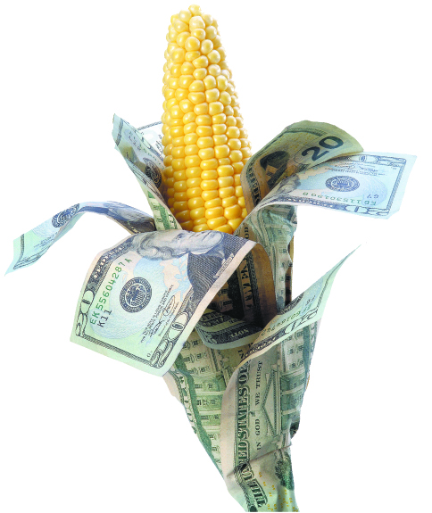
Precision Agriculture
(The Future of Farming/Ranching)
Increase farm/ranch production:
    Efficiency
    Productivity
    Profitability ($$$)
Credit: iStock

Slide 16
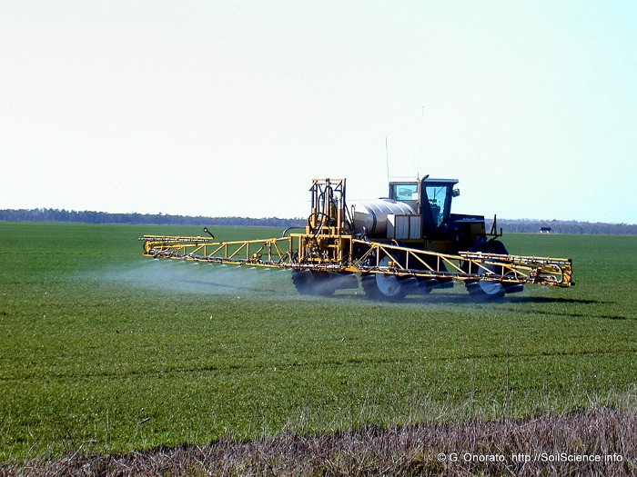
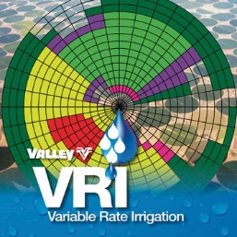
Precision Agriculture
(The Future of Farming/Ranching)
    2) impacts on wildlife and the environment

Slide 17
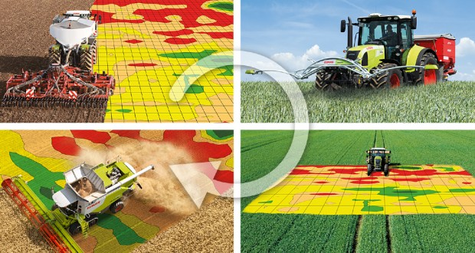
Precision Cropping
Credit: https://precisionagricultu.re/
Credit: https://tracextech.com/data-driven-agriculture/

Slide 18
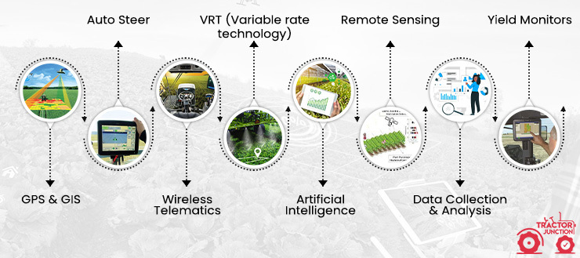
Precision Cropping Systems
Credit: https://tracextech.com/data-driven-agriculture/

Slide 19
Precision Conservation:
An Innovative Approach to Land Management

Slide 20
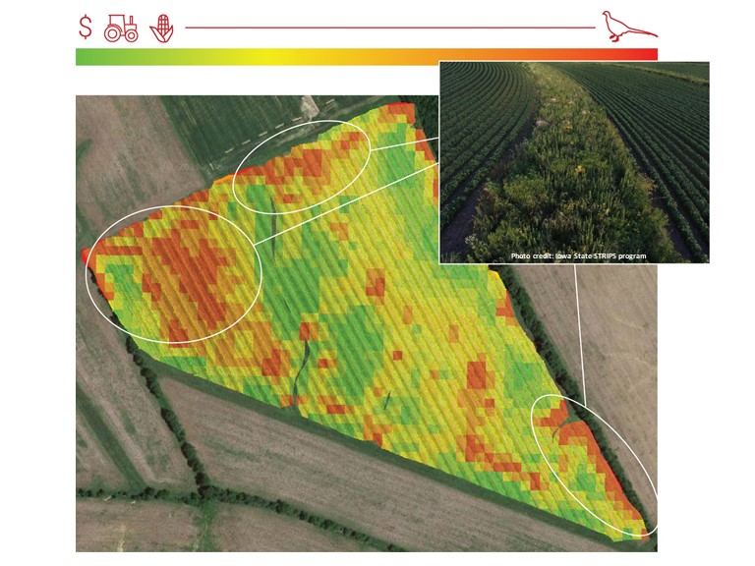
Where Does Precision Conservation Fit Into Farming?

Slide 21
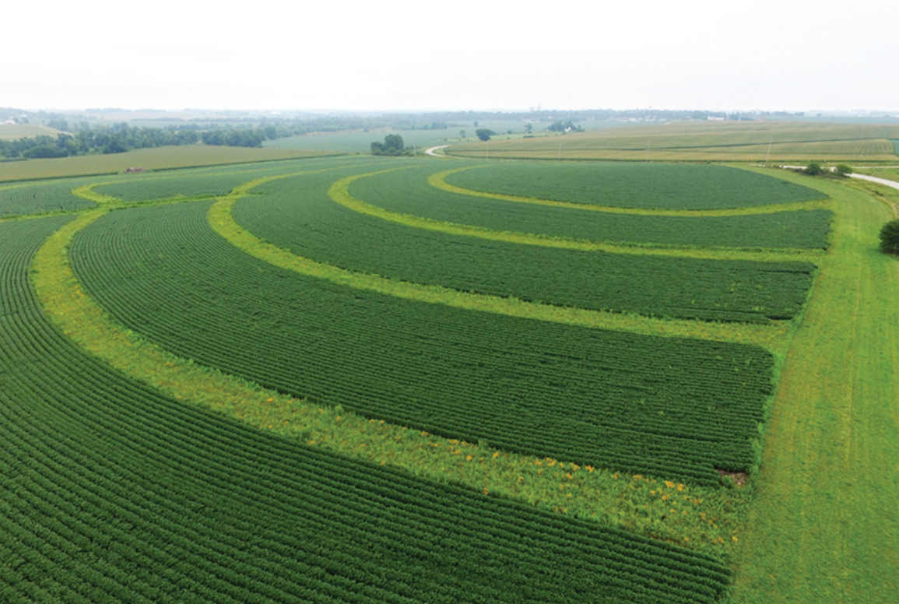
Precision Conservation
Helping farmers “find the balance” (e.g., production, soil health, water quality, wildlife)
Credit: ISU Prairie Strips

Slide 22
Precision Conservation
2) Improves landscape diversity
(e.g., prairie strips in Iowa)
    Adding 10% of corn/soybean fields into prairie
    37% in total water runoff
    20x in soil retention
    3x in avian species
Credit: ISU Prairie Strips

Slide 23
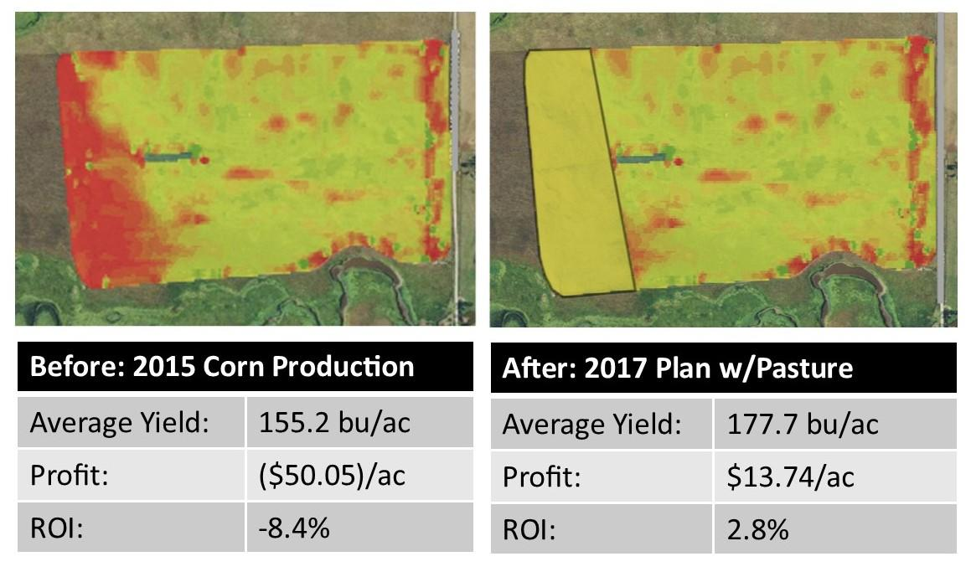
Precision Conservation
(The Future of Sustainable Farming)
Credit: Melissa Shockman (PF)

Slide 24
Precision Conservation
(The Future of Sustainable Farming)
Credit: Melissa Shockman (PF)

Slide 25
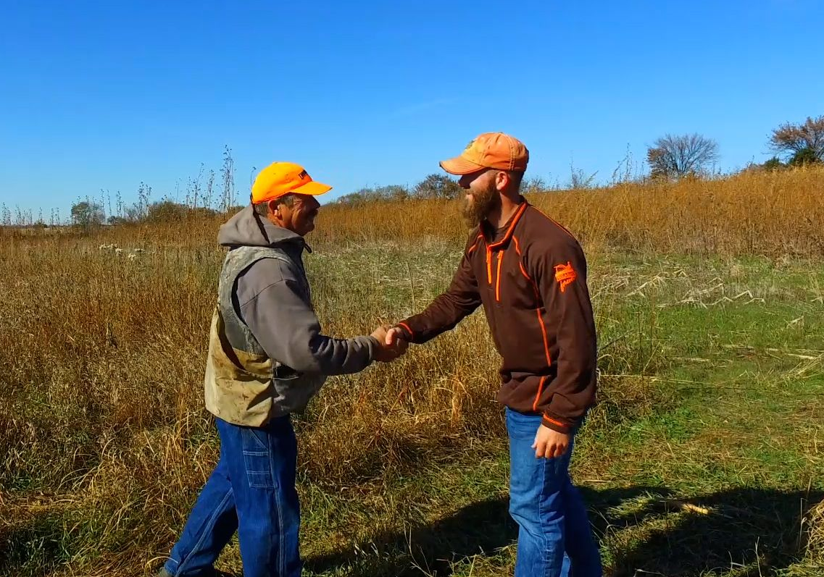
Precision Conservation
(The Future of Sustainable Farming)
Credit: Melissa Shockman (PF), Nebraska PF

Slide 26
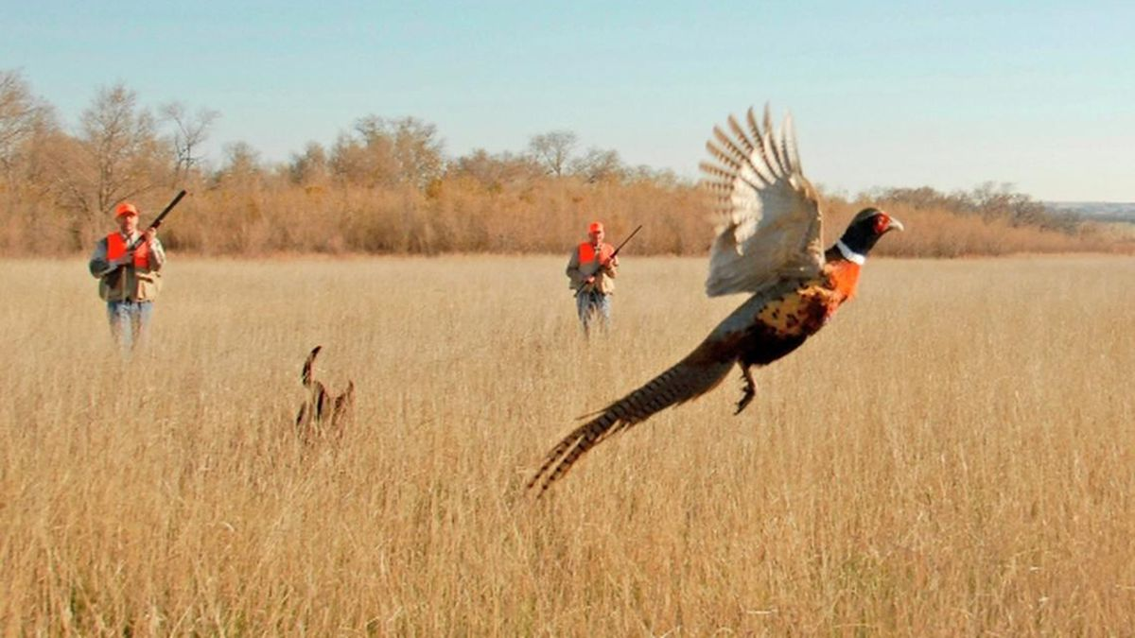
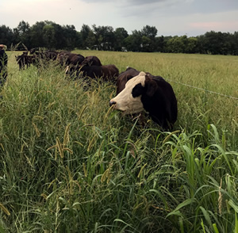
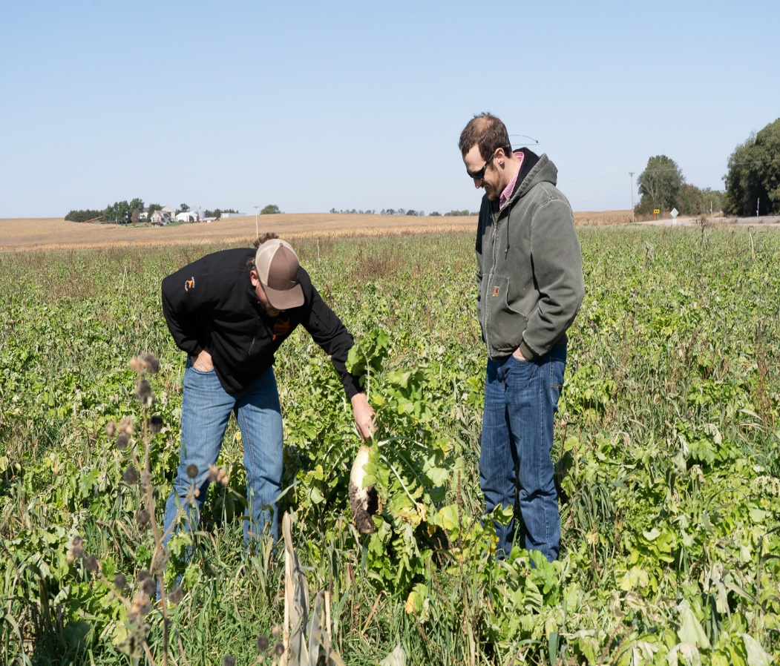
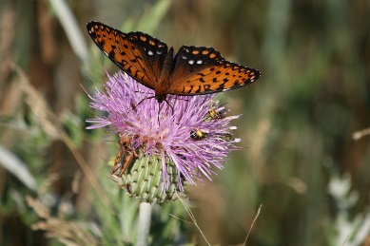
    Other Options to Include?
    Alternative Sources of Revenue and Ecosystem Benefits
Credits: Nebraska Pheasants Forever, South Dakota Department of Tourism, Iowa State University—Erika Lundy, Jessica Milby

Slide 27
Credit: Omar de Kok-Mercado/STRIPS

Slide 28
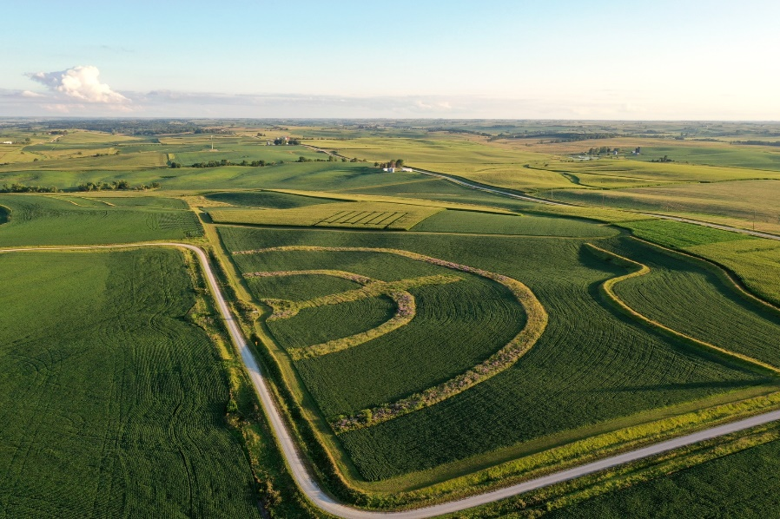
Conservation in Working Landscapes
Photo credit: Omar de Kok-Mercado
Credit: Lynn Betts, USDA, Nebraska PF

Slide 29
Implementing Prairie Strips (CP-43)
across Nebraska
Research Objectives:
Facilitate the establishment of prairie strips across a 7-state region
Multi-Institute Grant Collaborators:
University of Nebraska-Lincoln
Iowa State University
American Farmland Trust
Missouri Prairie Foundation
Michigan State University
University of Florida
University of Northern Iowa – Tallgrass Prairie Center
Sand County Foundation
Photo credit: Omar de Kok-Mercado
Credit: Lynn Betts, USDA

Slide 30
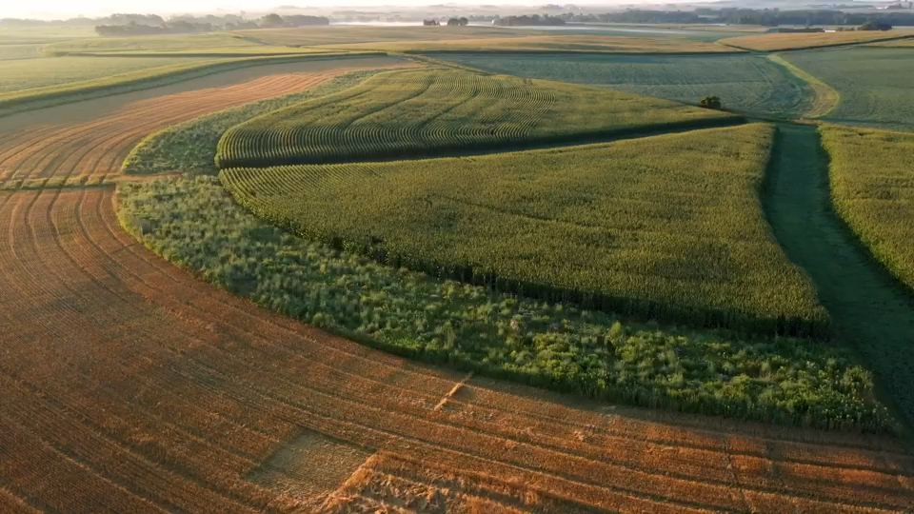
Example of Precision Conservation
(Prairie Strips CP-43)
Video credit: Ethan Freese and Iris McFarlin
Credit: Lynn Betts, USDA

Slide 31
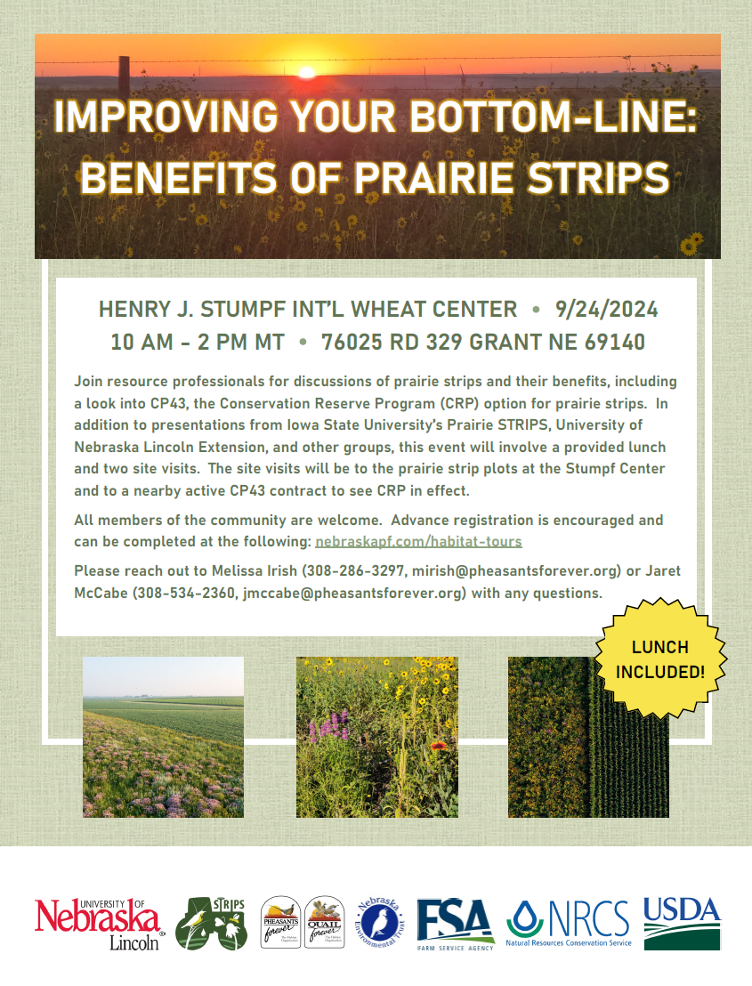
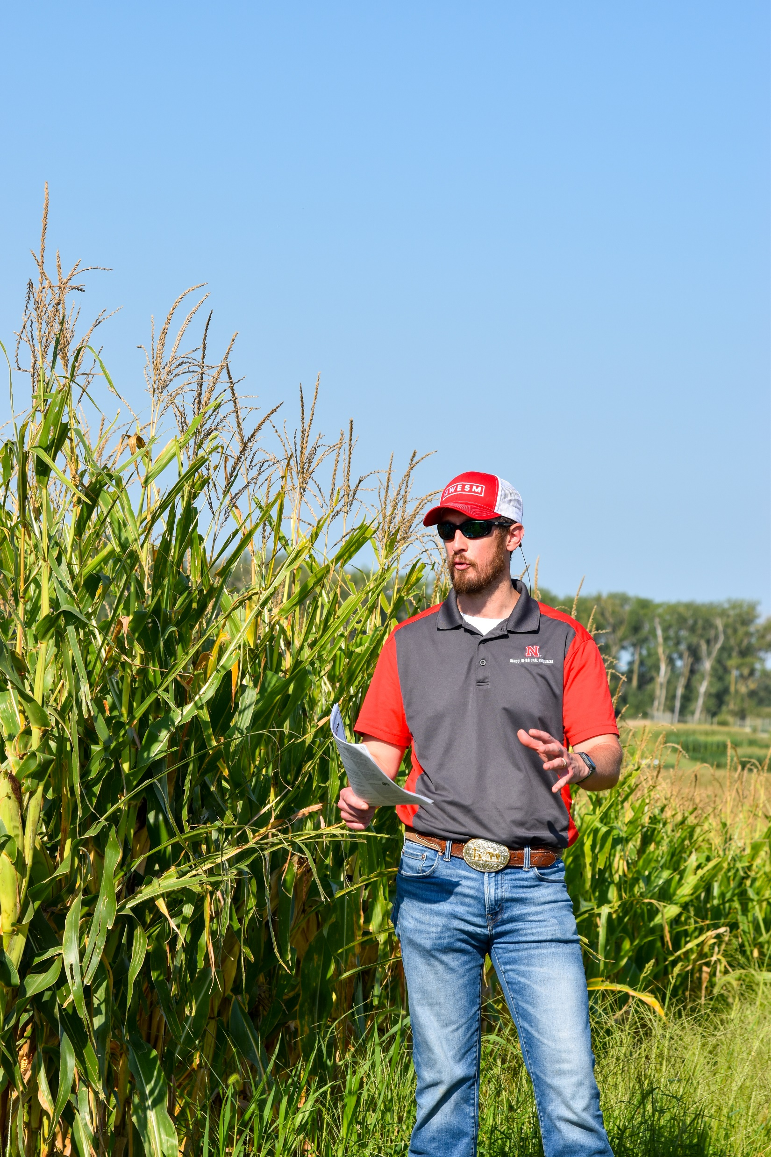
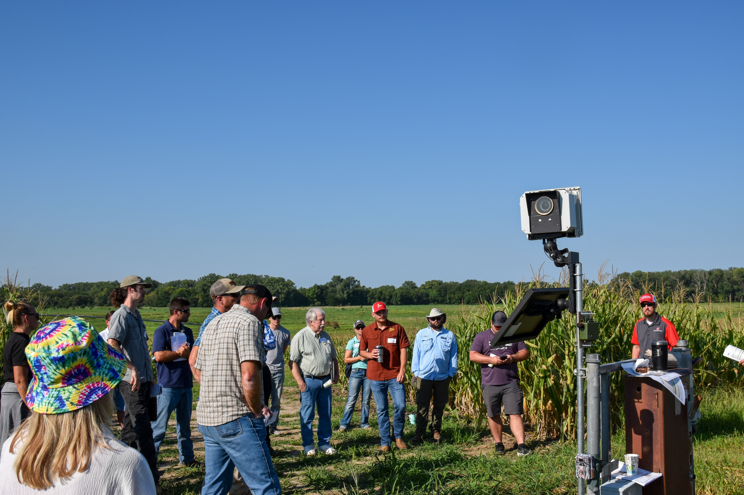
Debuting Prairie Strips (CP-43) Across Nebraska
Video credit: Ethan Freese and Iris McFarlin
Credit: Lynn Betts, USDA

Slide 32
Human Dimensions in Ag Landscapes
Credit: Lynn Betts, USDA

Slide 33
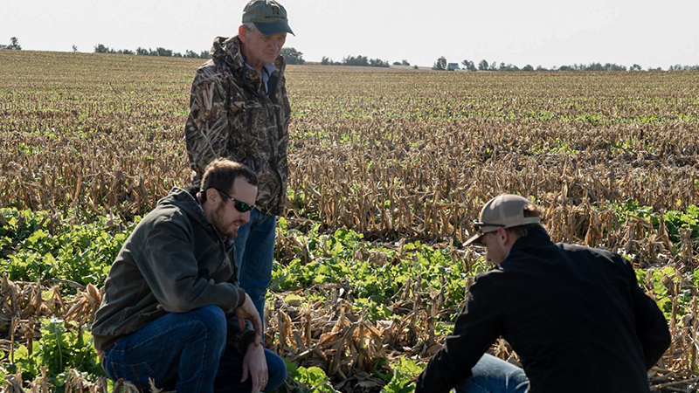
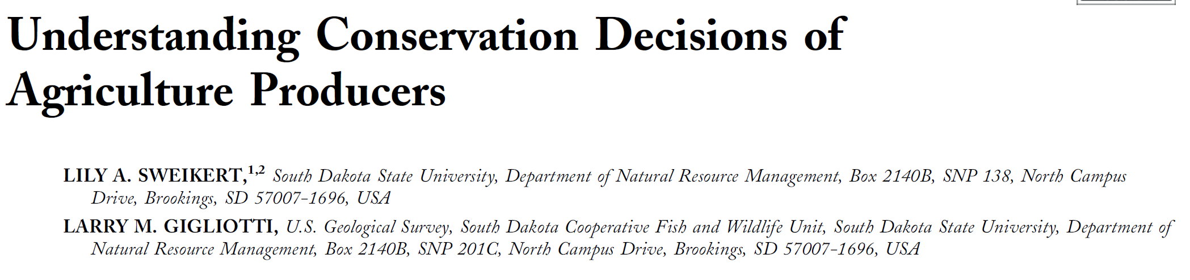
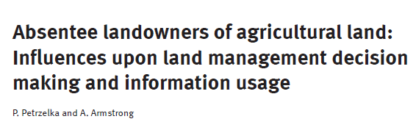

Precision Conservation Delivery –
Producer Relations
Nebraska farmers and farmland owners’ attitudes of targeted conservation
Credit: Nebraska Pheasants Forever

Slide 34

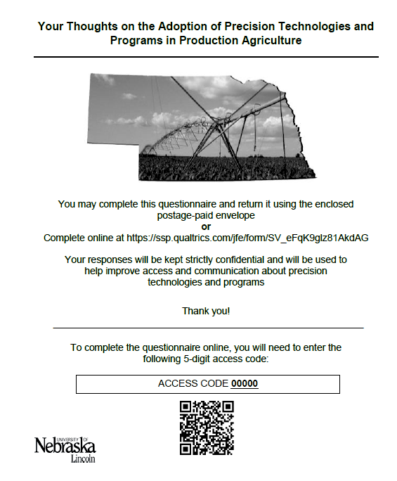
2022 Survey
01
18 Questions (14 Precision Ag. and 5 Producer Characteristics)
02
Mail Survey with Online Option
03
Half Distributed with Pens
Significant (p-value ≤ 0.05)
04
7503 Surveys Mailed
05
1041 Surveys Returned
Notes:
To answer these questions, I developed a survey with the help of experts from various conservation agencies and organizations. The survey consisted of 18 questions with 14 being related to precision agriculture and the other 5 being related to the producer's characteristics and operation (think age and crop type)
7503 survey were sent out with a mail and online option and half of our surveys were distributed with pens. The inclusion of a pen did result in a significantly higher return rate.
Of those 7503, 1041 were returned.

Slide 35
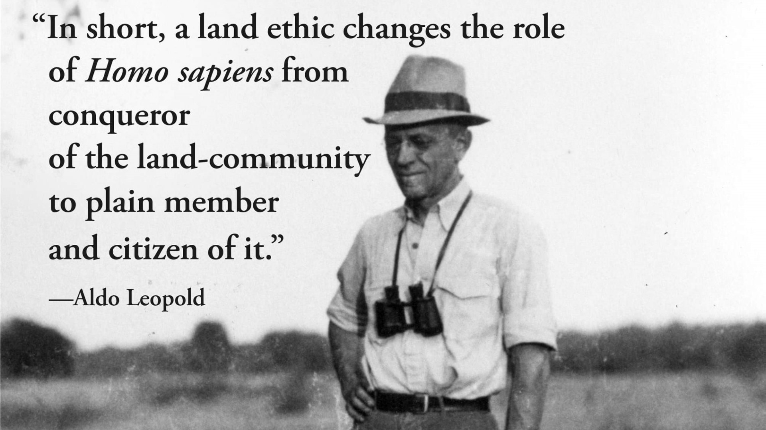
What Motivates Your Participation in Agriculture?
Feeding the World
Family legacy
Land Stewardship
Financial Benefit
Credit: Aldo Leopold Foundation
Notes:
For both applicants and non-applicants, friends family and peers, farm implemented manufacturers, and farmers organizations like co-ops were the preferred information source as you can see by the top three bars of the graph

Slide 36
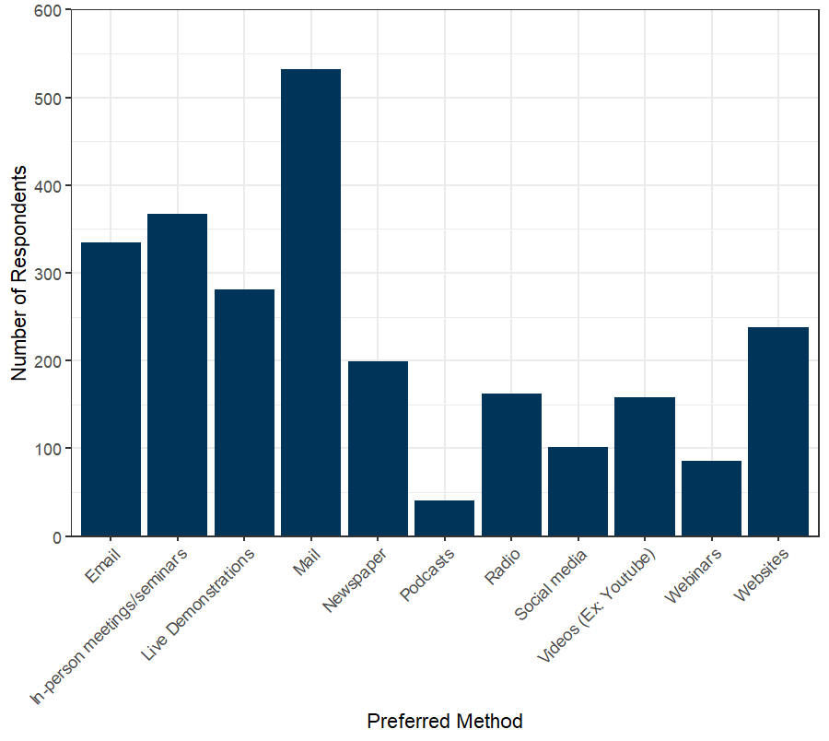
What Are Your Preferred Methods for Receiving Information About Precision Technologies and Conservation Programs/Incentives?
Mail
In-Person Meetings
Email
Live Demos
Notes:
For both applicants and non-applicants, friends family and peers, farm implemented manufacturers, and farmers organizations like co-ops were the preferred information source as you can see by the top three bars of the graph

Slide 37
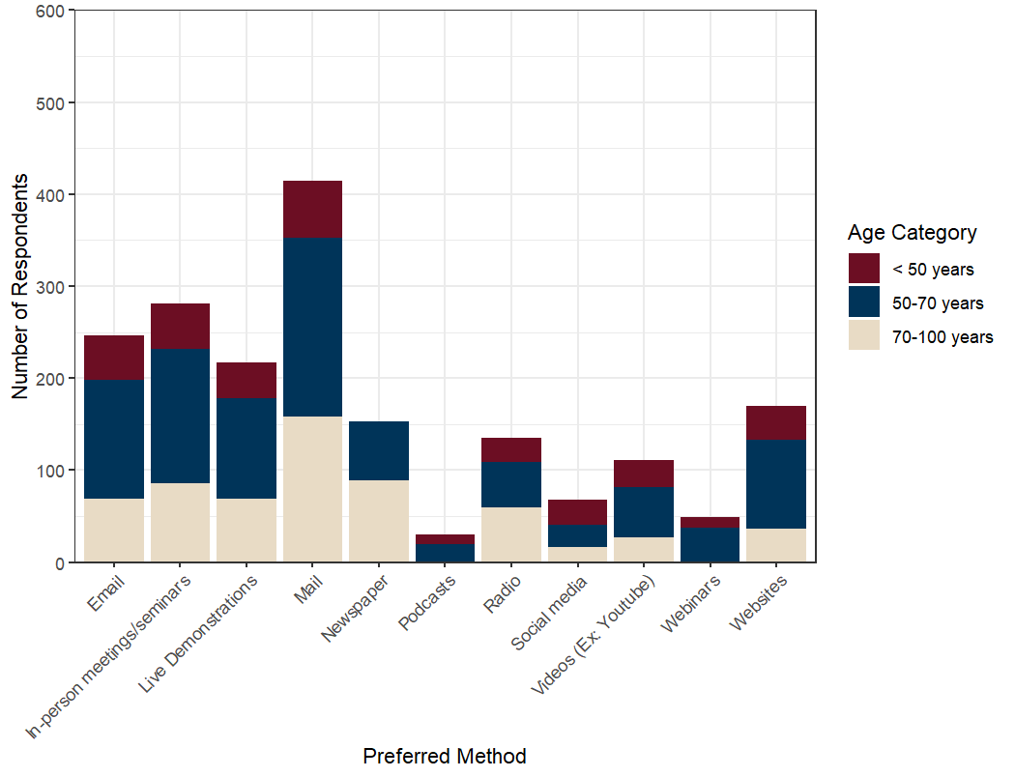
Information Dissemination by Age?
Notes:
For both applicants and non-applicants, friends family and peers, farm implemented manufacturers, and farmers organizations like co-ops were the preferred information source as you can see by the top three bars of the graph

Slide 38
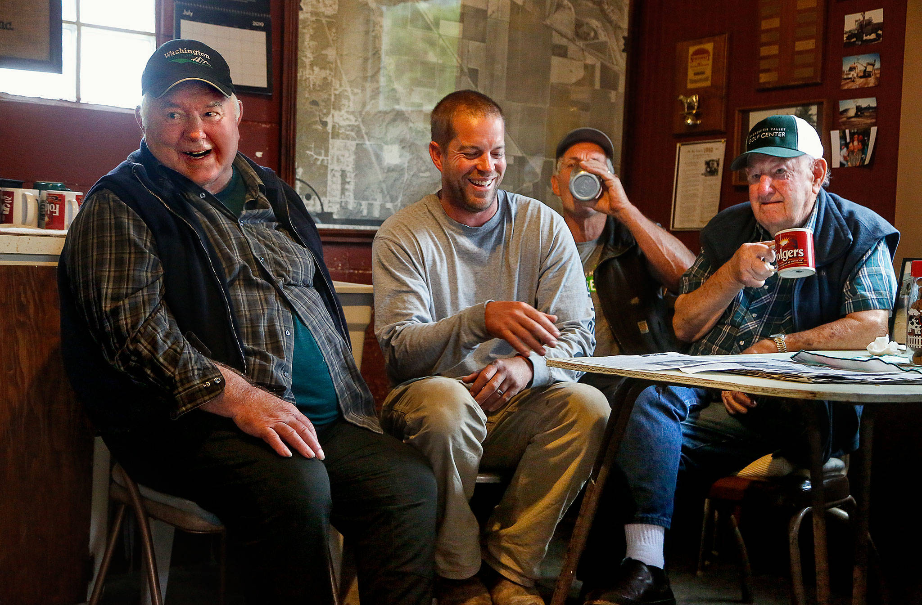
Where Do Farmers and Farmland Owners Get Their Information About Precision Technologies and Conservation?
Credit: Don Bates/The Herald
Notes:
For both applicants and non-applicants, friends family and peers, farm implemented manufacturers, and farmers organizations like co-ops were the preferred information source as you can see by the top three bars of the graph

Slide 39
Where Do Farmers and Farmland Owners Get Their Information About Precision Technologies and Conservation?
Who do you receive most of your information about precision technologies and conservation programs and incentives? (Please rank up to 11 sources, with 1 being your most used source)
___1 Friends, family, or peers
___2 Farmer’s organization (Ex: Co-op, Nebraska Farm Bureau)
___3 Farm oriented news network (Ex: Agriculture.com, Backyard farmer)
___4 University extension (Ex: UNL Extension)
___5 Non-government organization (Ex: Pheasants Forever, NWTF)
___6 Seed dealer
___7 Other 3rd Party (Ex: Agronomist)
___8 Farm implemented manufacturers
___9 Natural Resources Districts (NRD)
___10 Other State organization (Ex: Neb. Department of Agriculture)
___11 Farm Service Agency (FSA)
___12 Natural Resource Conservation Service (NRCS)
___13 Other Federal organization (Ex: U.S. Department of Agriculture)
___14 I have never received information about precision agriculture.

Slide 40
Where Do Farmers and Farmland Owners Get Their Information About Precision Technologies and Conservation?
Friends, Family, and Peers
Farm Organizations (e.g., implement manufacturers, coops, seed dealers, etc.)
University Extension
Credit: Don Bates/The Herald
Notes:
For both applicants and non-applicants, friends family and peers, farm implemented manufacturers, and farmers organizations like co-ops were the preferred information source as you can see by the top three bars of the graph

Slide 41
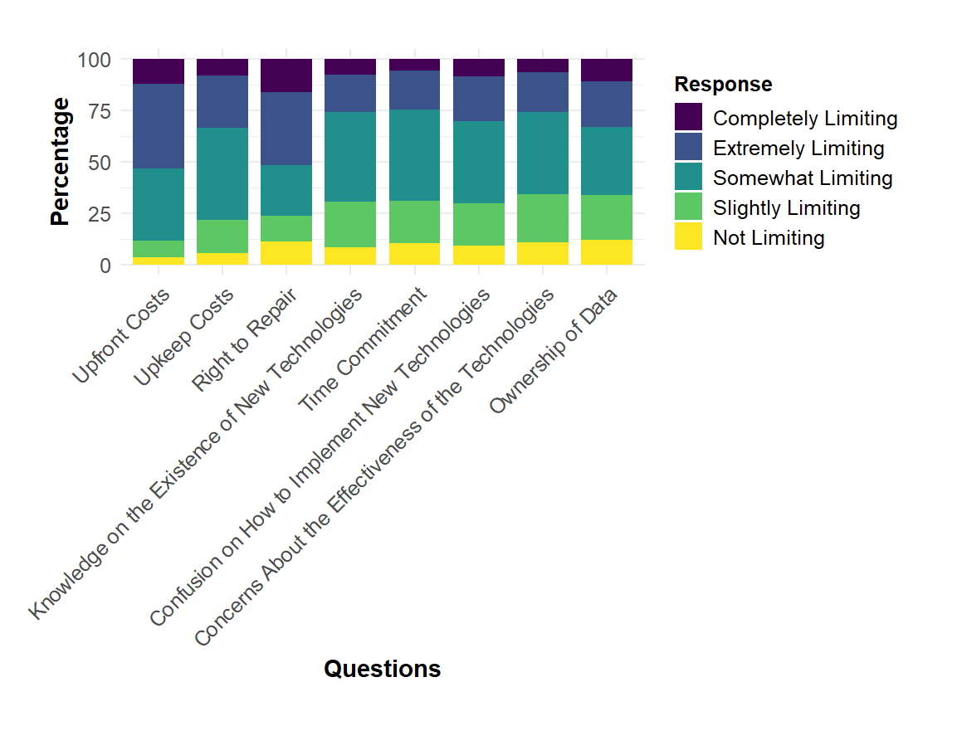
How Much Does Each of the Following Limit Your Ability to Adopt New Precision Technologies?
Notes:
For both applicants and non-applicants, friends family and peers, farm implemented manufacturers, and farmers organizations like co-ops were the preferred information source as you can see by the top three bars of the graph

Slide 42
How Much Does Each of the Following Limit Your Ability to Adopt New Precision Technologies?
76% said ‘upfront cost’ was somewhat to extremely limiting
Notes:
For both applicants and non-applicants, friends family and peers, farm implemented manufacturers, and farmers organizations like co-ops were the preferred information source as you can see by the top three bars of the graph

Slide 43
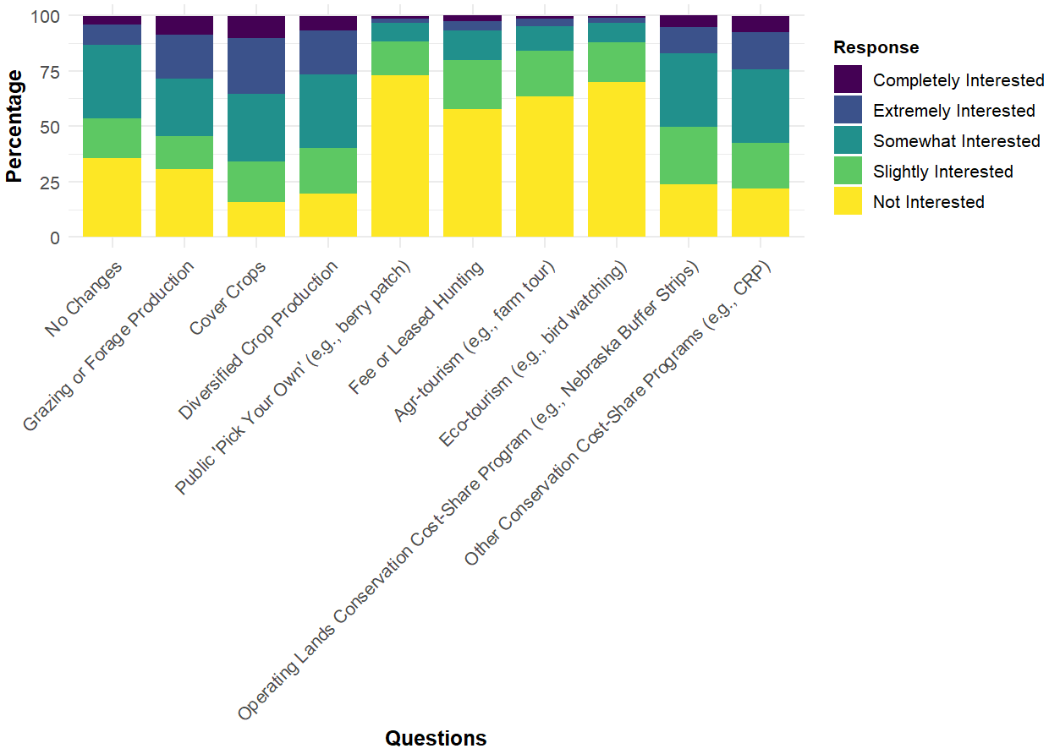
How Interested Are You in Following Ways to Diversify Your Low-Yielding Acres?
Notes:
For both applicants and non-applicants, friends family and peers, farm implemented manufacturers, and farmers organizations like co-ops were the preferred information source as you can see by the top three bars of the graph

Slide 44


Winter (2023) Results Also Illustrate The Need for Farmer-Led Initiatives Like Conservation Cooperatives
Credit: Practical Farmers of Iowa
Notes:
For both applicants and non-applicants, friends family and peers, farm implemented manufacturers, and farmers organizations like co-ops were the preferred information source as you can see by the top three bars of the graph

Slide 45



What are Conservation Cooperatives
(or Farmer Clusters)?
“A conservation cooperative (or farmer cluster) is a group of farmers, living in the same area that share their knowledge, support, and help motivate each other to improve biodiversity and the ecological health of their farms.”
– Game and Wildlife Conservation Trust

Slide 46


It’s Also Complicated!
Notes:
For both applicants and non-applicants, friends family and peers, farm implemented manufacturers, and farmers organizations like co-ops were the preferred information source as you can see by the top three bars of the graph

Slide 47
So Where Do We Go From Here…
Photo credit: Omar de Kok-Mercado
Credit: Lynn Betts, USDA, Nebraska PF

Slide 48

2 Key Focal Areas to Improve Adoption of Conservation in Ag Landscapes
Connecting Conservation Professionals and Improving Education on Production Agriculture Systems for All Ages
Creating Collaborative Networks for Landowners, Conservation Professionals, Ag Industry, etc. to Engage and Solve Complex Challenges
Credit: Deb Mashek
Credit: Lynn Betts, USDA, Nebraska PF

Slide 49



Create Synergy By Partnering Together as a Conservation Community!
(August 2023)

Slide 50


Natural Resources Conservation Connecting Points Workshop
(April 2024)

Slide 51



Training Opportunities for Conservation Professionals on Production Ag Systems

Slide 52





Create a Collaborative Network
(Ag Producers, Ag Industry,
Conservation Professionals, UNL, etc.)
Ag Producers
Ag Industry
Conservation Professionals

Slide 53




    Be Creative…Designing Stackable Enterprises!
$
$
Credits: Nati Hamik, Nebraska Pheasants Forever, Joel Sartore, Sue Loudon, and UNL

Slide 54




    Be Innovative…Local Economic Development!
Precision Farming/Ranching
Credits: Adobe Stock Images

Slide 55

Andrew Little, Ph.D
Asst. Professor of Landscape Ecology and Habitat Mgmt.
School of Natural Resources
University of Nebraska-Lincoln
Email: alittle6@unl.edu
Follow us at @awesmlab
Credit: Lynn Betts, USDA

