Slide 1
ACEP Introduction
Nebraska
Roger Yerdon, Easement Program Manager

Slide 2
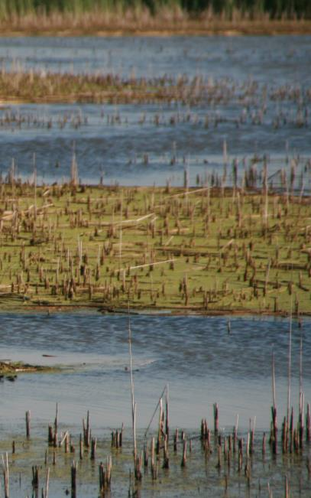
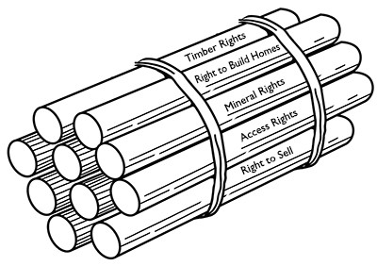
ACEP – What is a Conservation Easement?
Conservation Easement
Power invested in a qualified conservation organization or government to constrain the exercise of rights otherwise held by a landowner so as to achieve certain conservation purposes.
Conservation Easements
One of the rights in the bundle of property rights
Voluntarily sold or donated by landowner
Conservation purposes
Conservation Easement
Notes:
What are the conservation purposes?
Restore, protect, and enhance wetlands;
Maintain and improve migratory bird habitat and migration corridors;
Protect agricultural viability by limiting non-ag uses;
Protect scenic vistas visible from roads and other public areas;

Slide 3
Conservation Easement History via Farm Bill
1985 – Food Security Act
1990 – Food, Agriculture Conservation and Tract Act
1996 – Federal Agriculture Improvement and Reform
    Act
2002 – Farm Security and Rural Investment Act
2008 – Food Conservation and Energy Act
2014 – Agriculture Act of 2014
2018 – Agriculture Improvement Act of 2018
2023 - TBD
Conservation Easement Timeline
1990 – WRP
1996 – FPP
2002 – GRP and FRPP
2014 - ACEP
Notes:
1985 Conservation of wetlands related in agricultural production. Also introduced CRP (cousin of easements).
1990 Created Wetland Reserve Program.
1996 Expanded WRP enrollment options and created FPP.
2002 Created Grassland Reserve Program and renamed FPP to FRPP.
2008 WRP limited to private ag and lands owned by Indian Tribes.
2014 Introduced Agricultural Conservation Easement Program and Regional Conservation Partnership Program.
2018 Increased funding for ACEP. Provided entities who hold easements more flexibility and control over land stewardship requirements and management actions.

Slide 4
ACEP – Currently
ALE & GSS
Protect the long-term viability of working lands from non-agricultural uses.
WRE & WREP
Provide habitat for fish, migratory birds and wildlife, improve water quality, reduce flooding, and recharge groundwater.
Conservation Easements
ALE & GSS – Working Lands
WRE & WREP – Migratory Bird Habitat
Other/Old Programs
EWPP-FPE
EWRP
FRPP
GRP
RCPP
WRP
Notes:
688 CE on 126,590 acres in Nebraska. 96% of the easements are wetland easements as are about 2/3 of the easement acres.

Slide 5
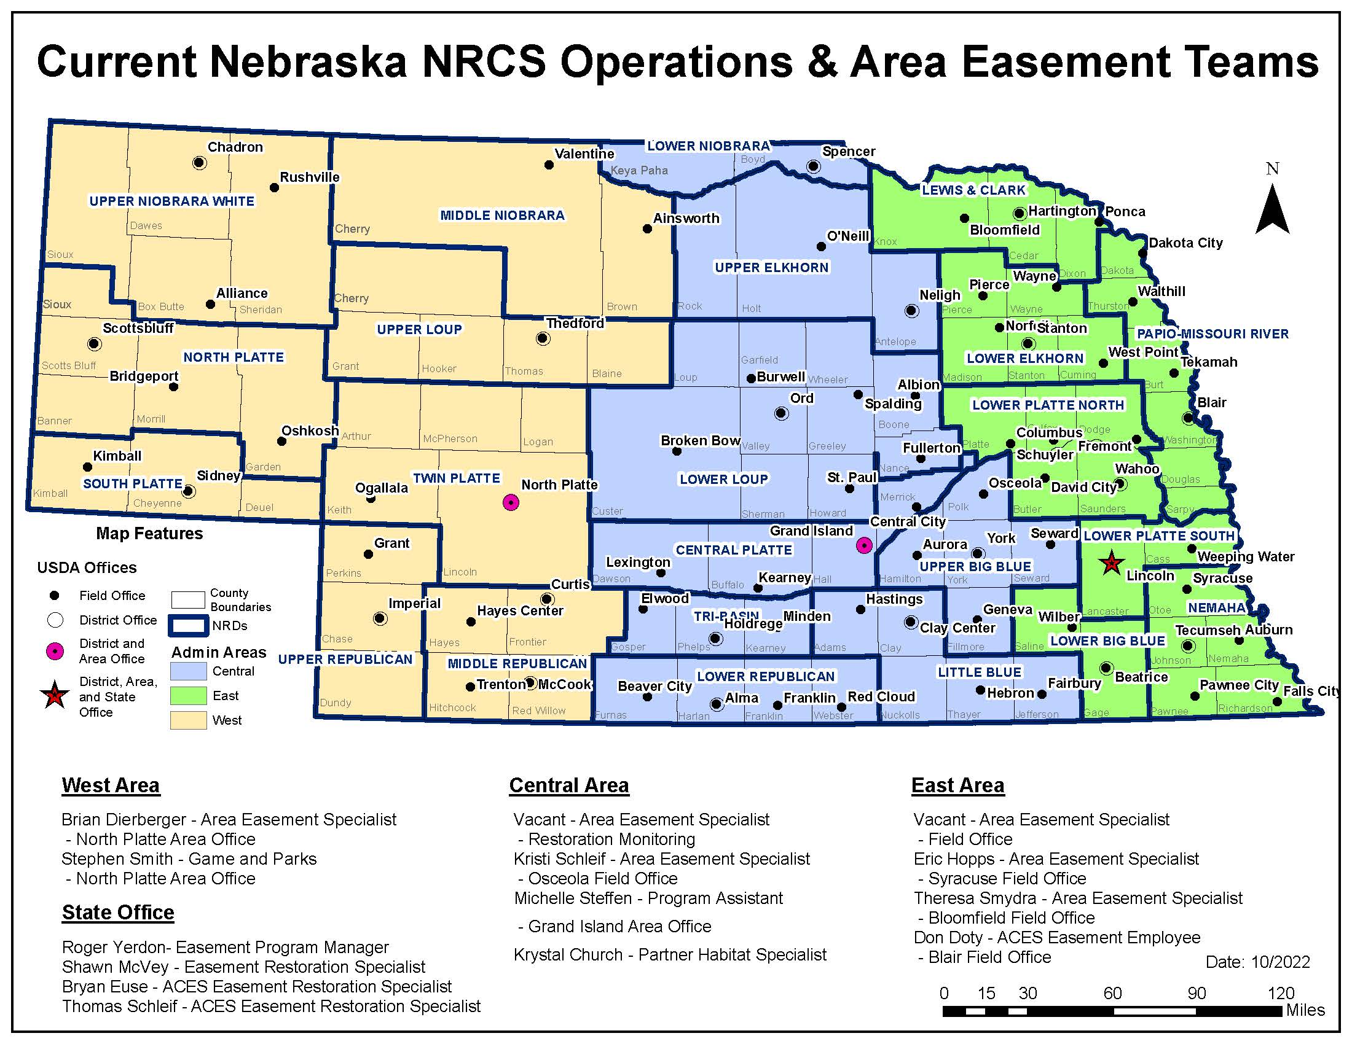
ACEP in Nebraska
Who Works on Easements
Landowner
Appraiser
Surveyor
Realty Specialists
Financial Mgmt
Title Company
Attorney (OGC)
Internal Controls
Wildlife Organizations and Agencies
Notes:
Landowner
Local NRCS Field Office Staff
Area Easement Specialist
Area Engineers and CET's
Biologists
Soil Scientists
State Office Easement Staff
GIS Specialist
Other wildlife organizations
and agencies
Appraisers
Realty Specialists
Financial Mgt.
Title Company
Surveyors
NEST Support
Internal Controls
Attorneys (OGC)
Closing Agent

