Slide 1
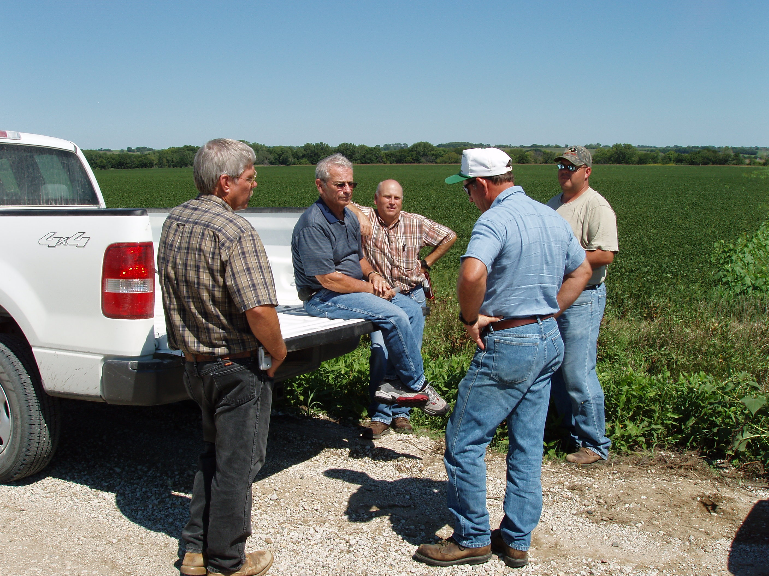
BE – TEAMS (Bio-Engineering Teams)
History
NE early 2000’s
Modelled after MO NRCS
Reduce programmatic burden on county NRCS offices.
Originally 7 Teams
Current link to West, Central, East Operation Areas
Role
Facilitate regional delivery of WRE
Assimilate subject matter experts within relevant scientific and programmatic disciplines
Federal, State, NGO’s, Local Resource Agencies etc.
Biology, Ecology, Hydrology, Soils, Engineering etc.
Responsibility
Collaborate in the evaluation of WRE applications
Workload Prioritization Tool (Ranking Worksheet)
Preliminary wetland restoration design
Management Plan & CUA’s

