Slide 1
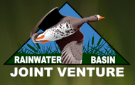


Economics of Playa Wetland Conservation Programs: A Case Study
Jordan Rodriguez, Ron Seymour, Andy Bishop

Slide 2
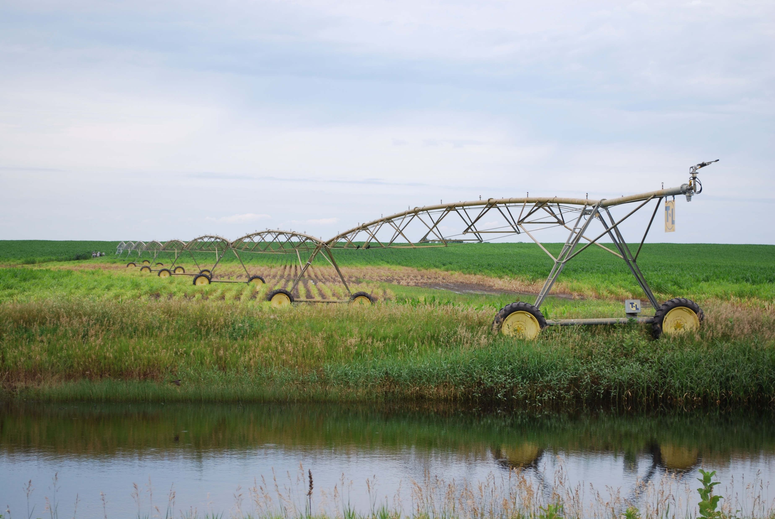
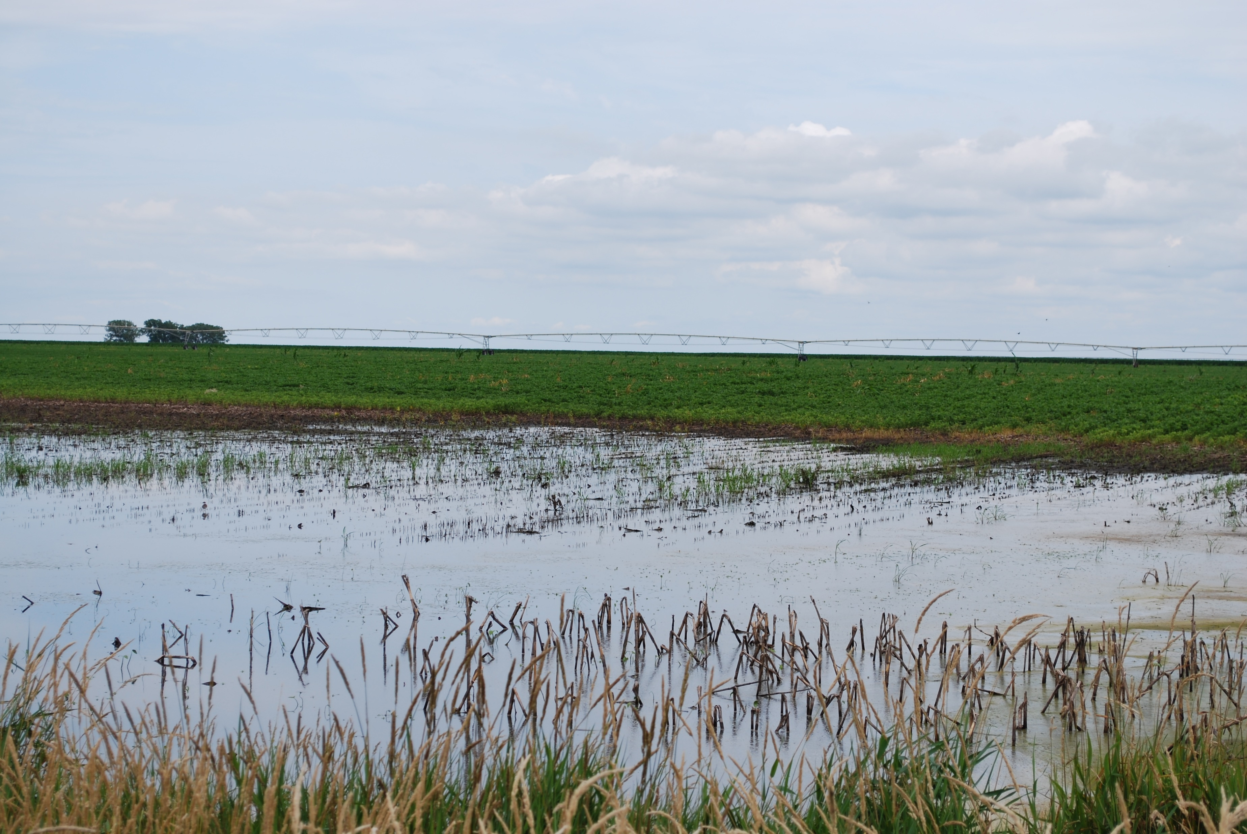
Farm field with a playa wetland

Slide 3
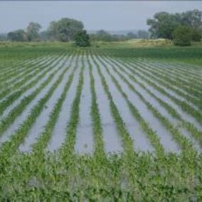
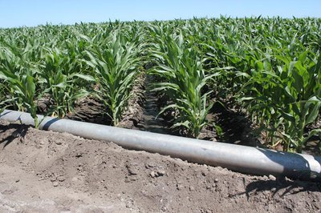
Adjacent field with gravity irrigation
Photo: Fred Knapp, NET News
Photo: Tamra Jackson-Ziems, Nebraska Extension

Slide 4
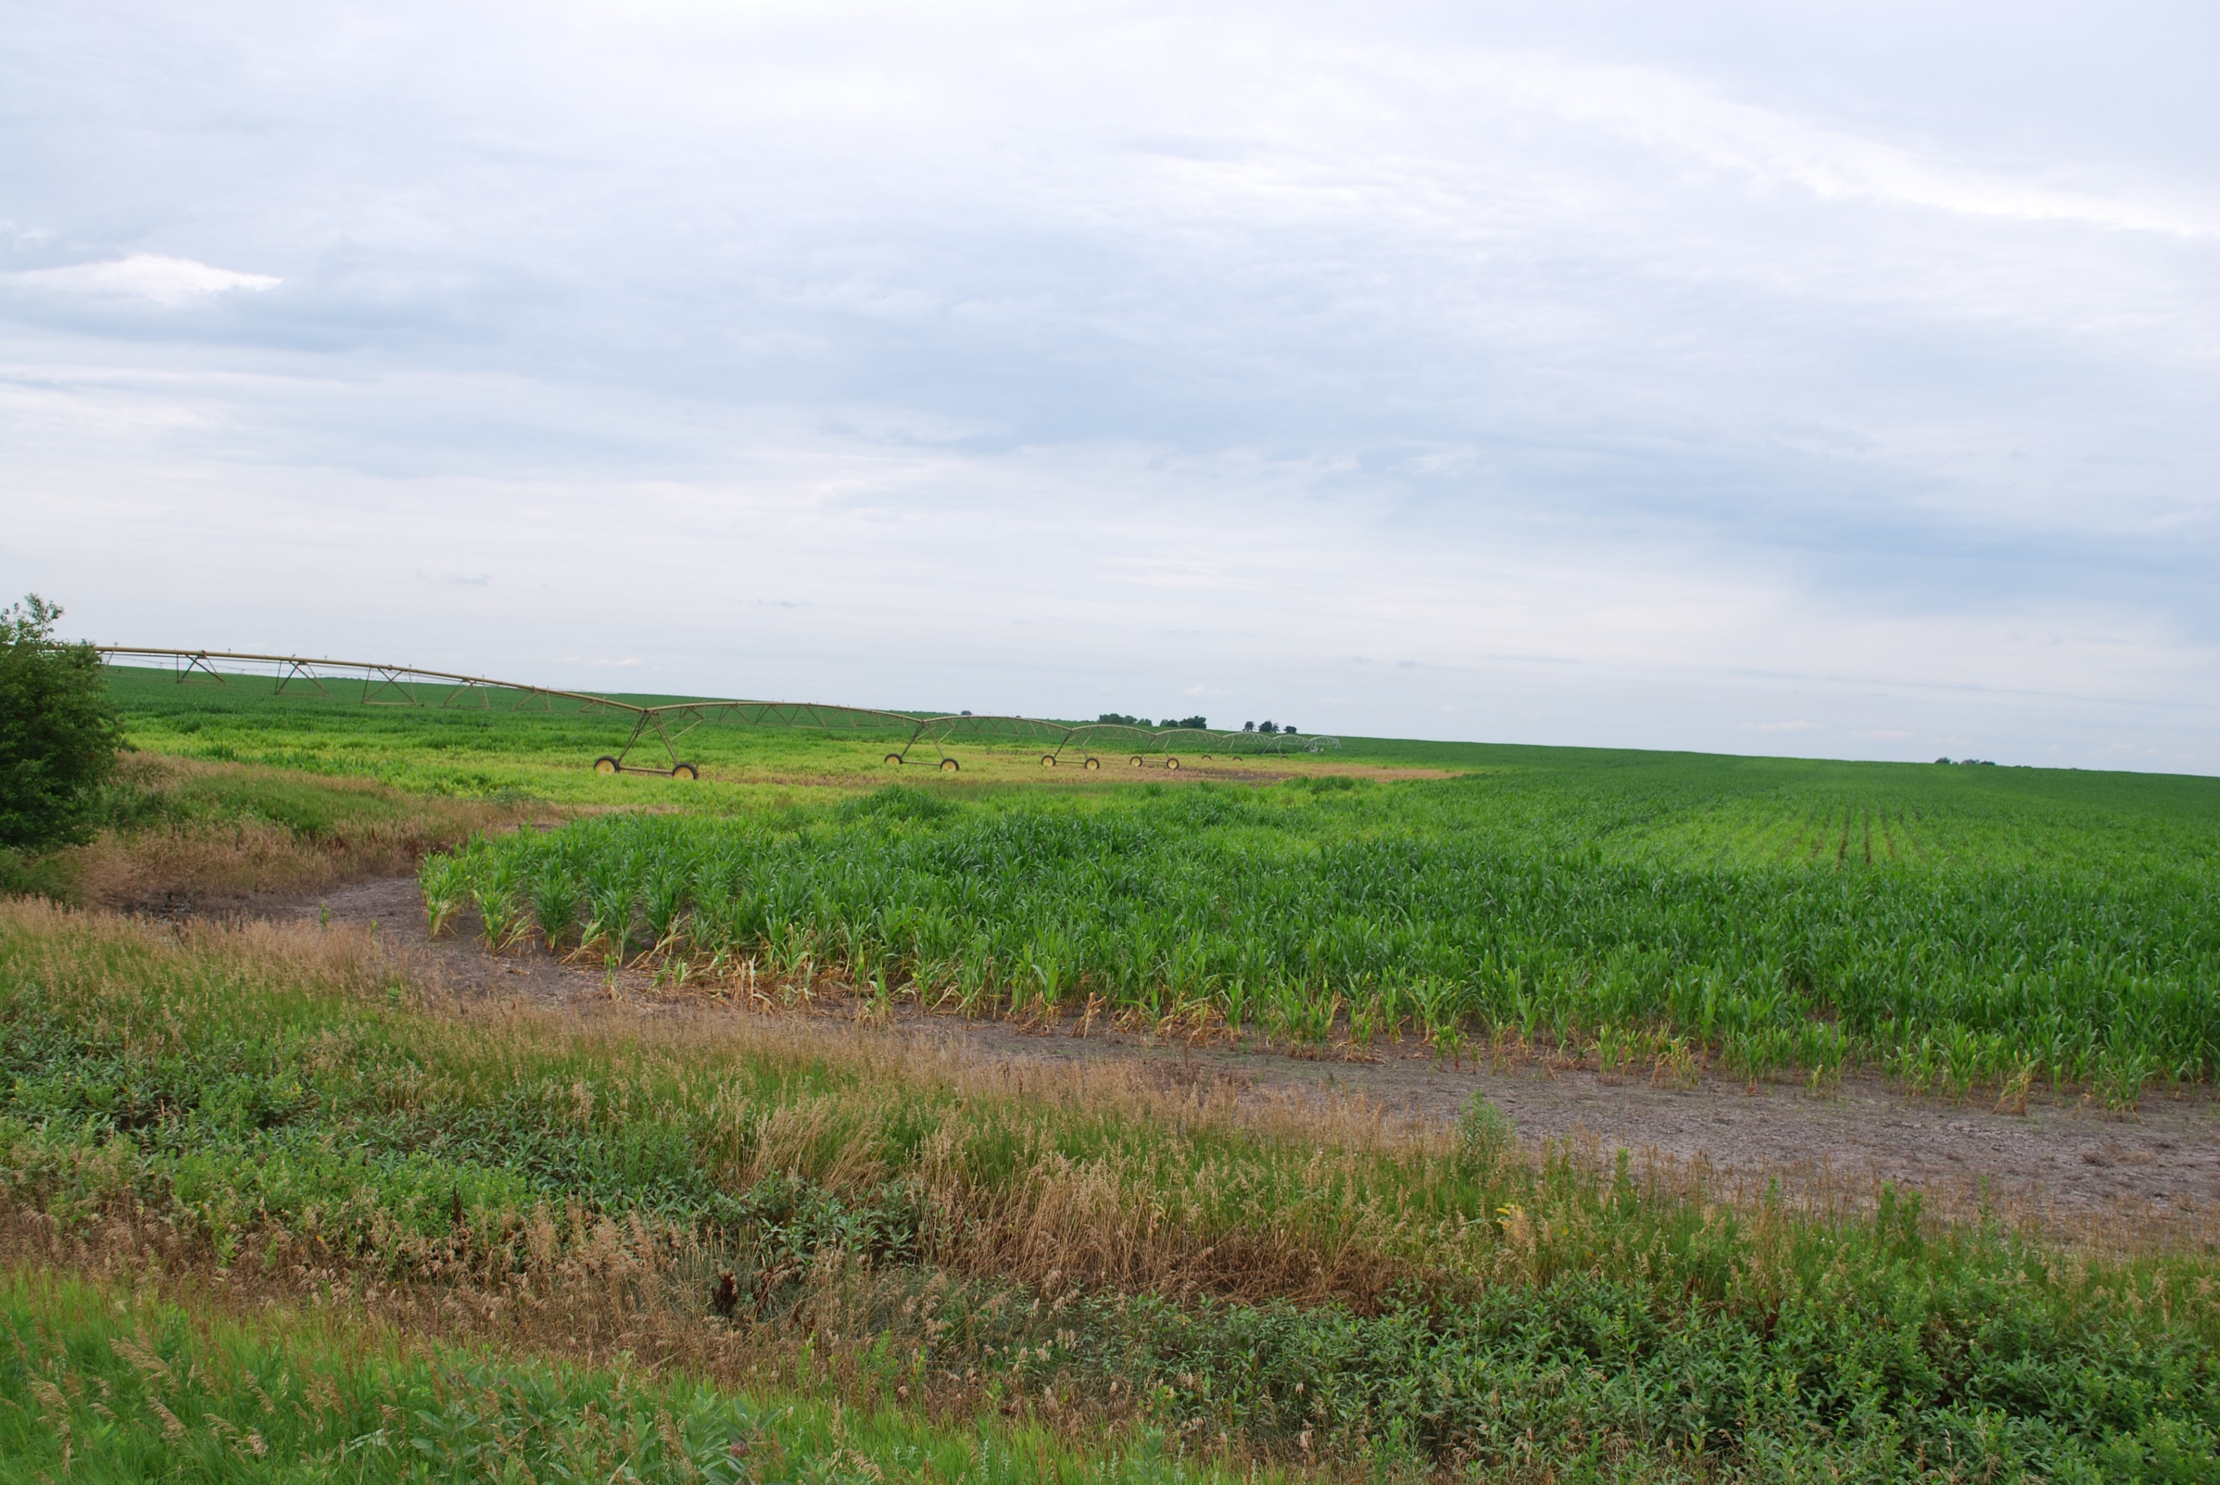
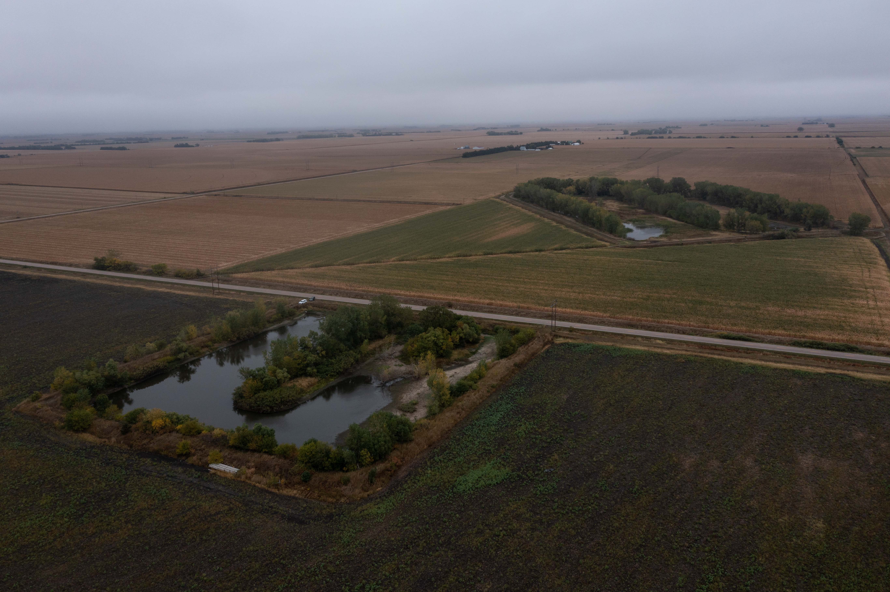
Crop condition

Slide 5
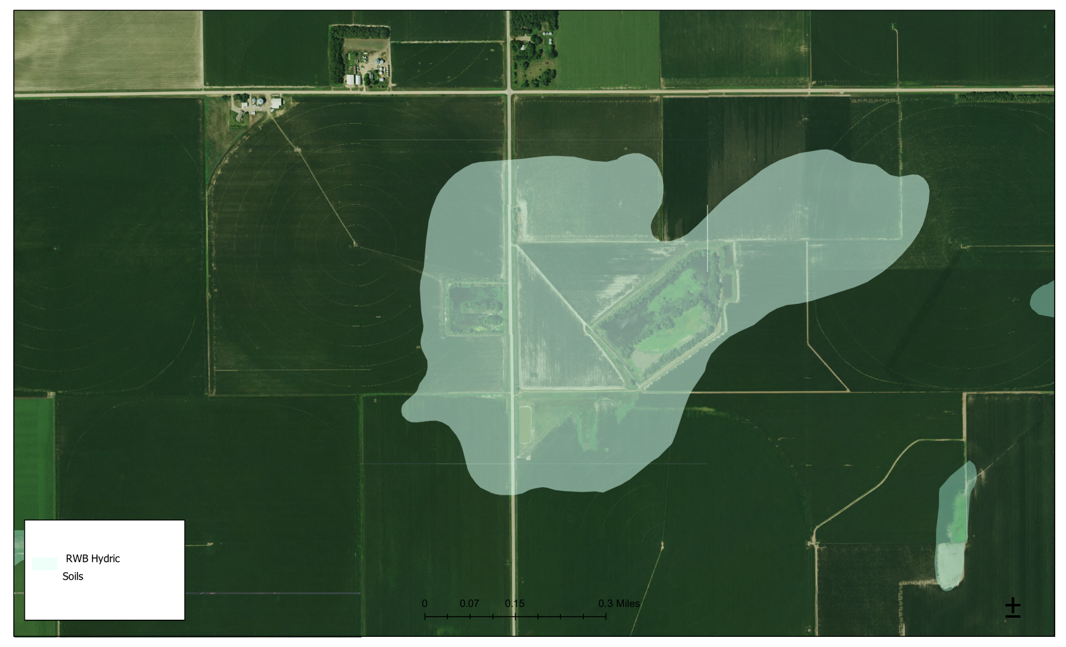
Playa wetland in 2020
Pond
Pond
Gravity
Irrigated
Field
Gravity
irrigated
field

Slide 6
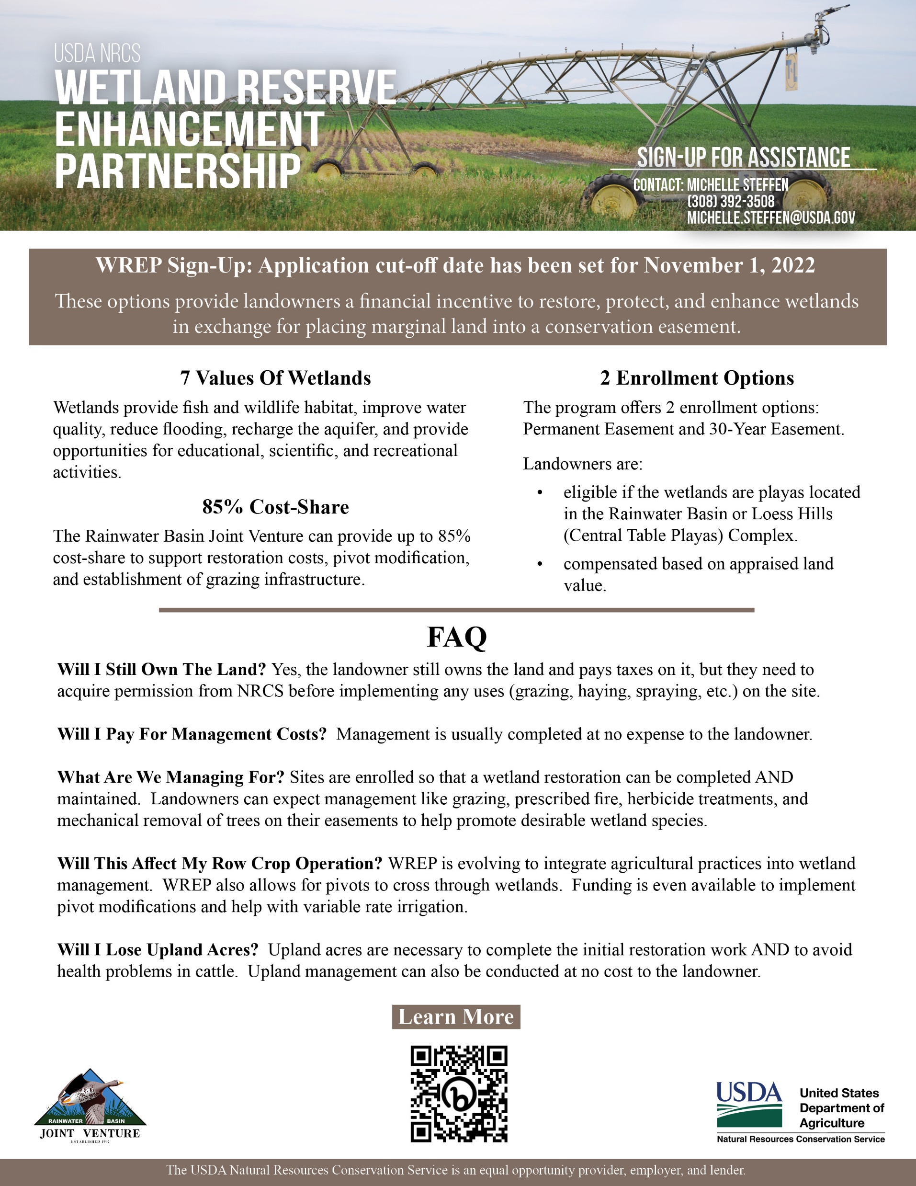
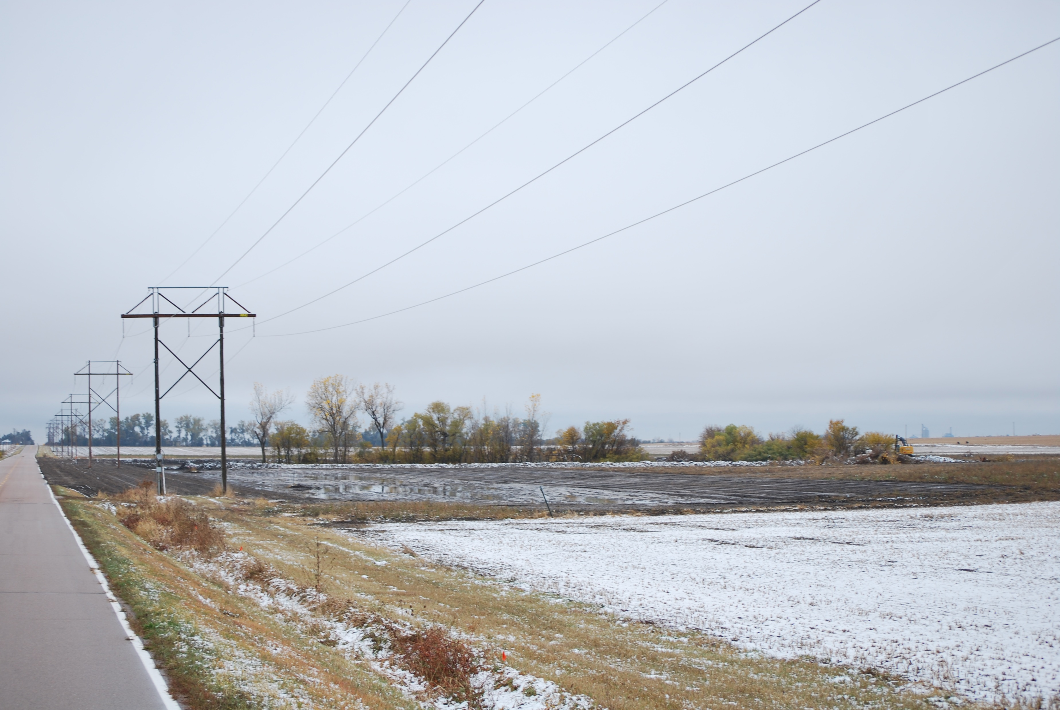
Solution to the issues?

Slide 7
Landowner Agreement No: NE-64850-21-11
CFDA: 15.631
PARTNERS FOR FISH AND WILDLIFE PROGRAM LANDOWNER AGREEMENT
This Landowner Agreement (Agreement), dated October 1, 2020, between Nick and Tracy Happold (Landowner)(s), Precision Agronomy Solutions®, Nebraska Community Foundation (NCF) for its affiliated fund the Rainwater Basin Joint Venture (RWBJV), Nebraska Game and Parks Commission (NGPC) and the U.S. Fish and Wildlife Service (USFWS) is entered into pursuant to authority contained in the Partners for Fish and Wildlife Act (P.L. 109-294), the Fish and Wildlife Coordination Act (16 U.S.C. 661 et seq.) and the Fish and Wildlife Act of 1956 (16 U.S.C. 742a-j), as amended. This project was selected for funding because the Landowner(s) share(s) a common objective with the RWBJV, NGPC, USFWS, and the other cooperating partners identified above, to enhance habitat for the benefit of Federal trust species on private lands. The project supports priority actions identified in the Regional Partners for Fish and Wildlife (Partners) Program Strategic Plan.
Nick and Tracy Happold, 449 W Binfield Rd, Doniphan, NE 68832, (308) 380-8871, hereby agrees to participate with the RWBJV, NGPC, and the USFWS in conducting certain wildlife management practices on lands owned or managed by them in Hall County, State of Nebraska, described as follows: all of, or within, NE¼ of Section 16, Township 9 North, Range 9 West (see Exhibit B).

Slide 8
Landowner rights and expectations
The Landowner, with authority over land management decisions, warrants that there are no outstanding rights that interfere with this Landowner Agreement.
The Landowner retains all rights to control trespass and retains all responsibility for taxes, insurance, assessments, and damage claims.
The Landowner agrees to allow the Project to occur on the property.
The Landowner agrees to provide partial funding for the Project as outlined in this Agreement.

Slide 9
Landowner rights and expectations
The Landowner will notify the RWBJV of pending changes in ownership. A change of ownership of the property shall be subject to the terms of this Agreement. The Agreement shall be in effect on the described land for the term of the Agreement.
During the habitat retention period, the Landowner(s) agree(s) to maintain the habitat restored under this award per Exhibit A and allow the habitat restored under this award to remain in place.
At the end of the habitat retention period, the habitat improvement project will become the sole property and complete responsibility of the Landowner(s). There shall be no obligation to the RWBJV, NGPC and USFWS after the term of the Agreement has expired.

Slide 10
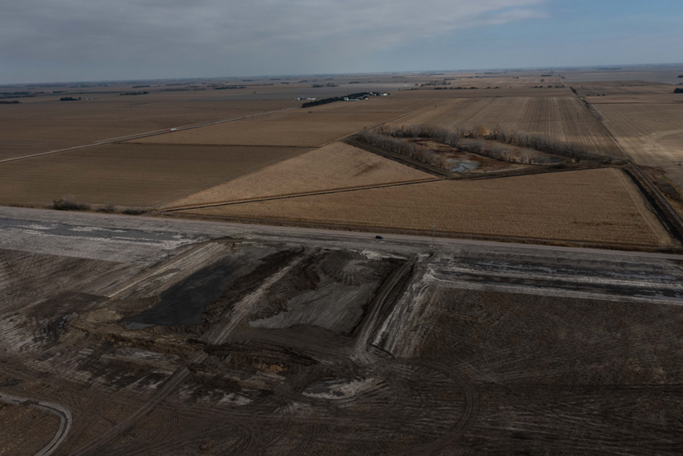
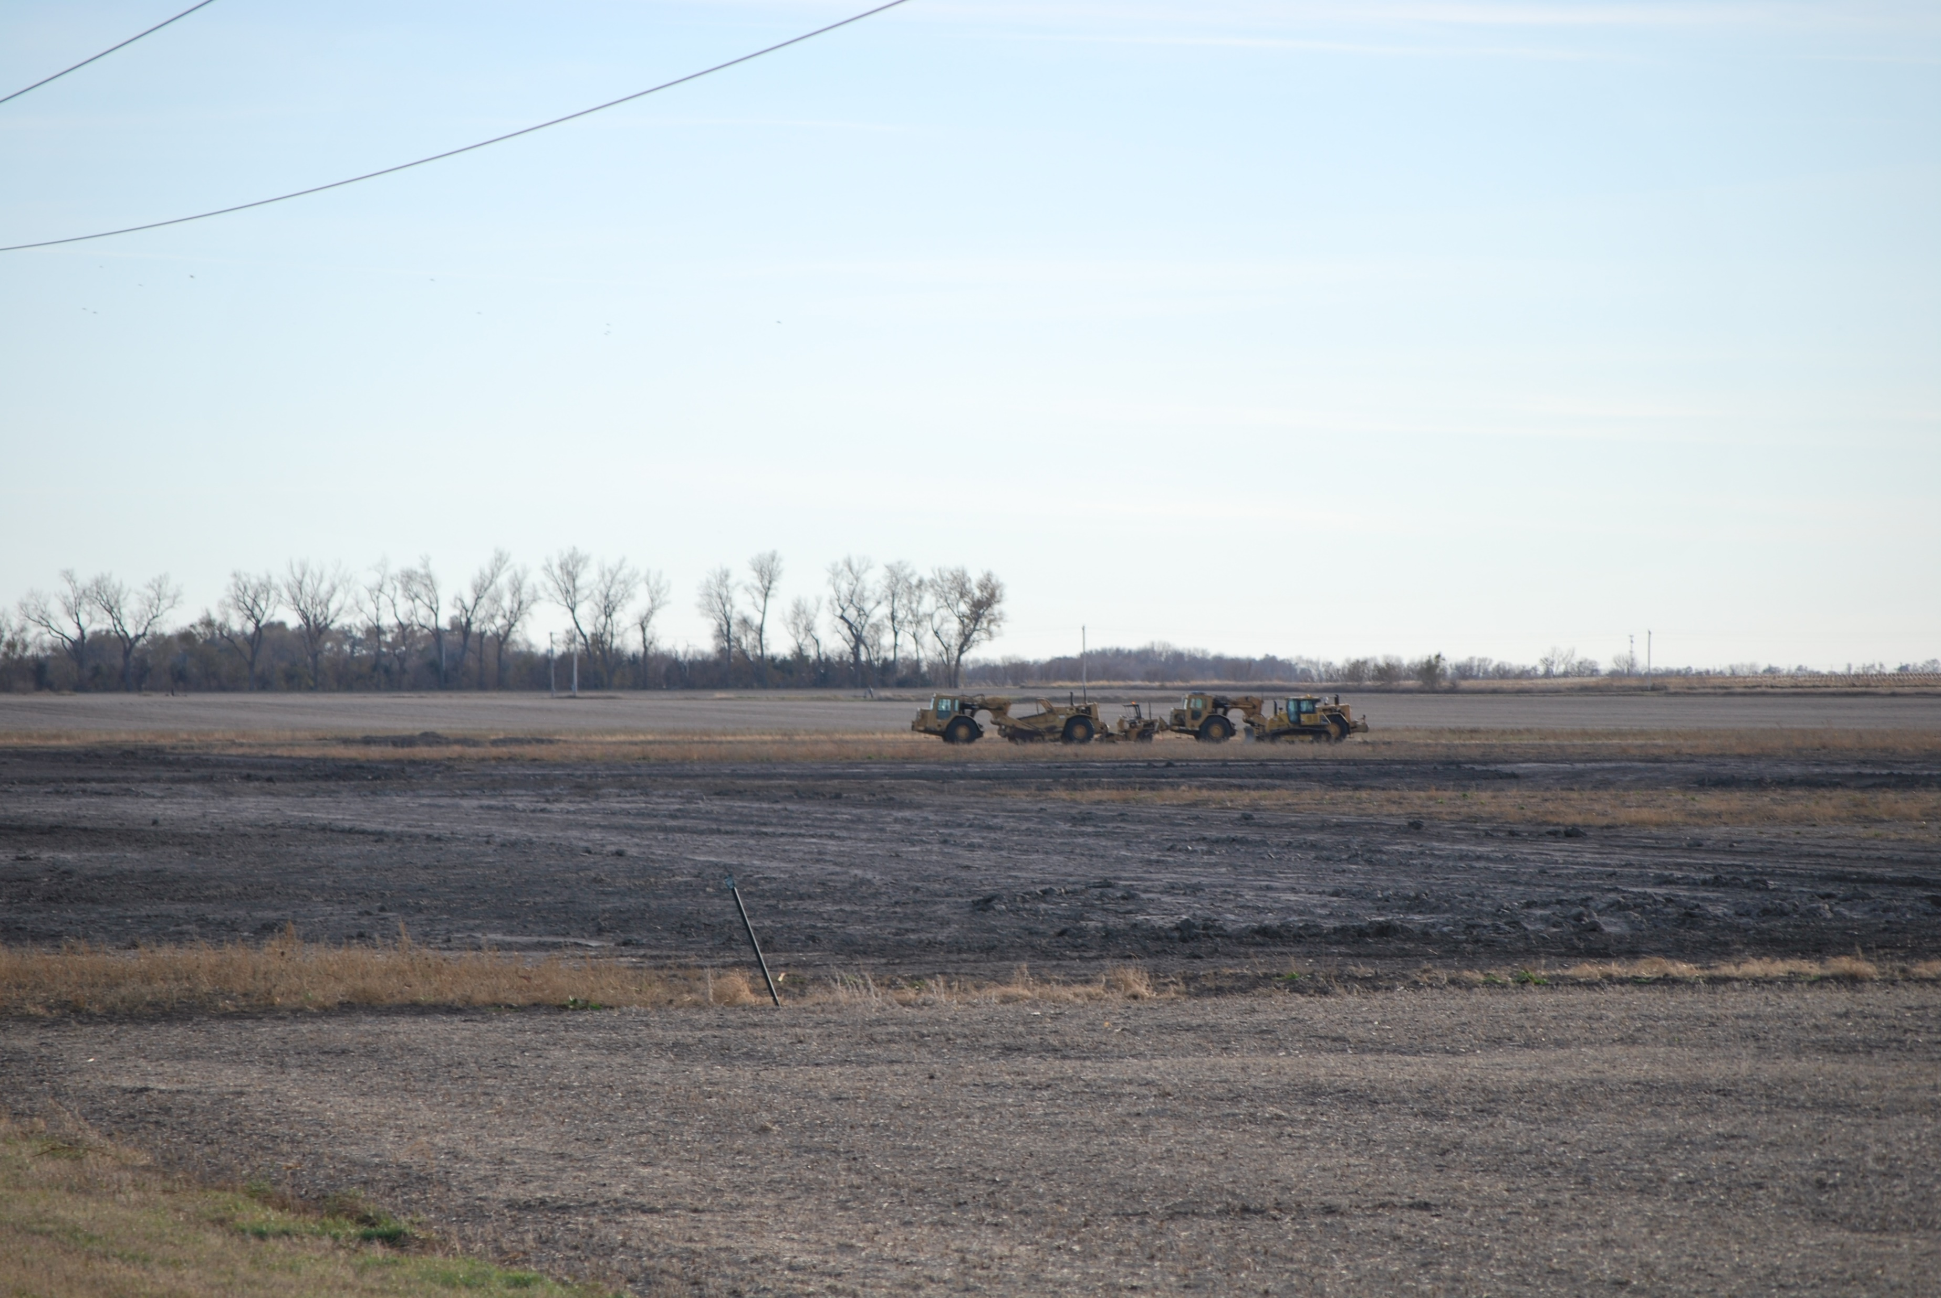
Removal of impoundment

Slide 11
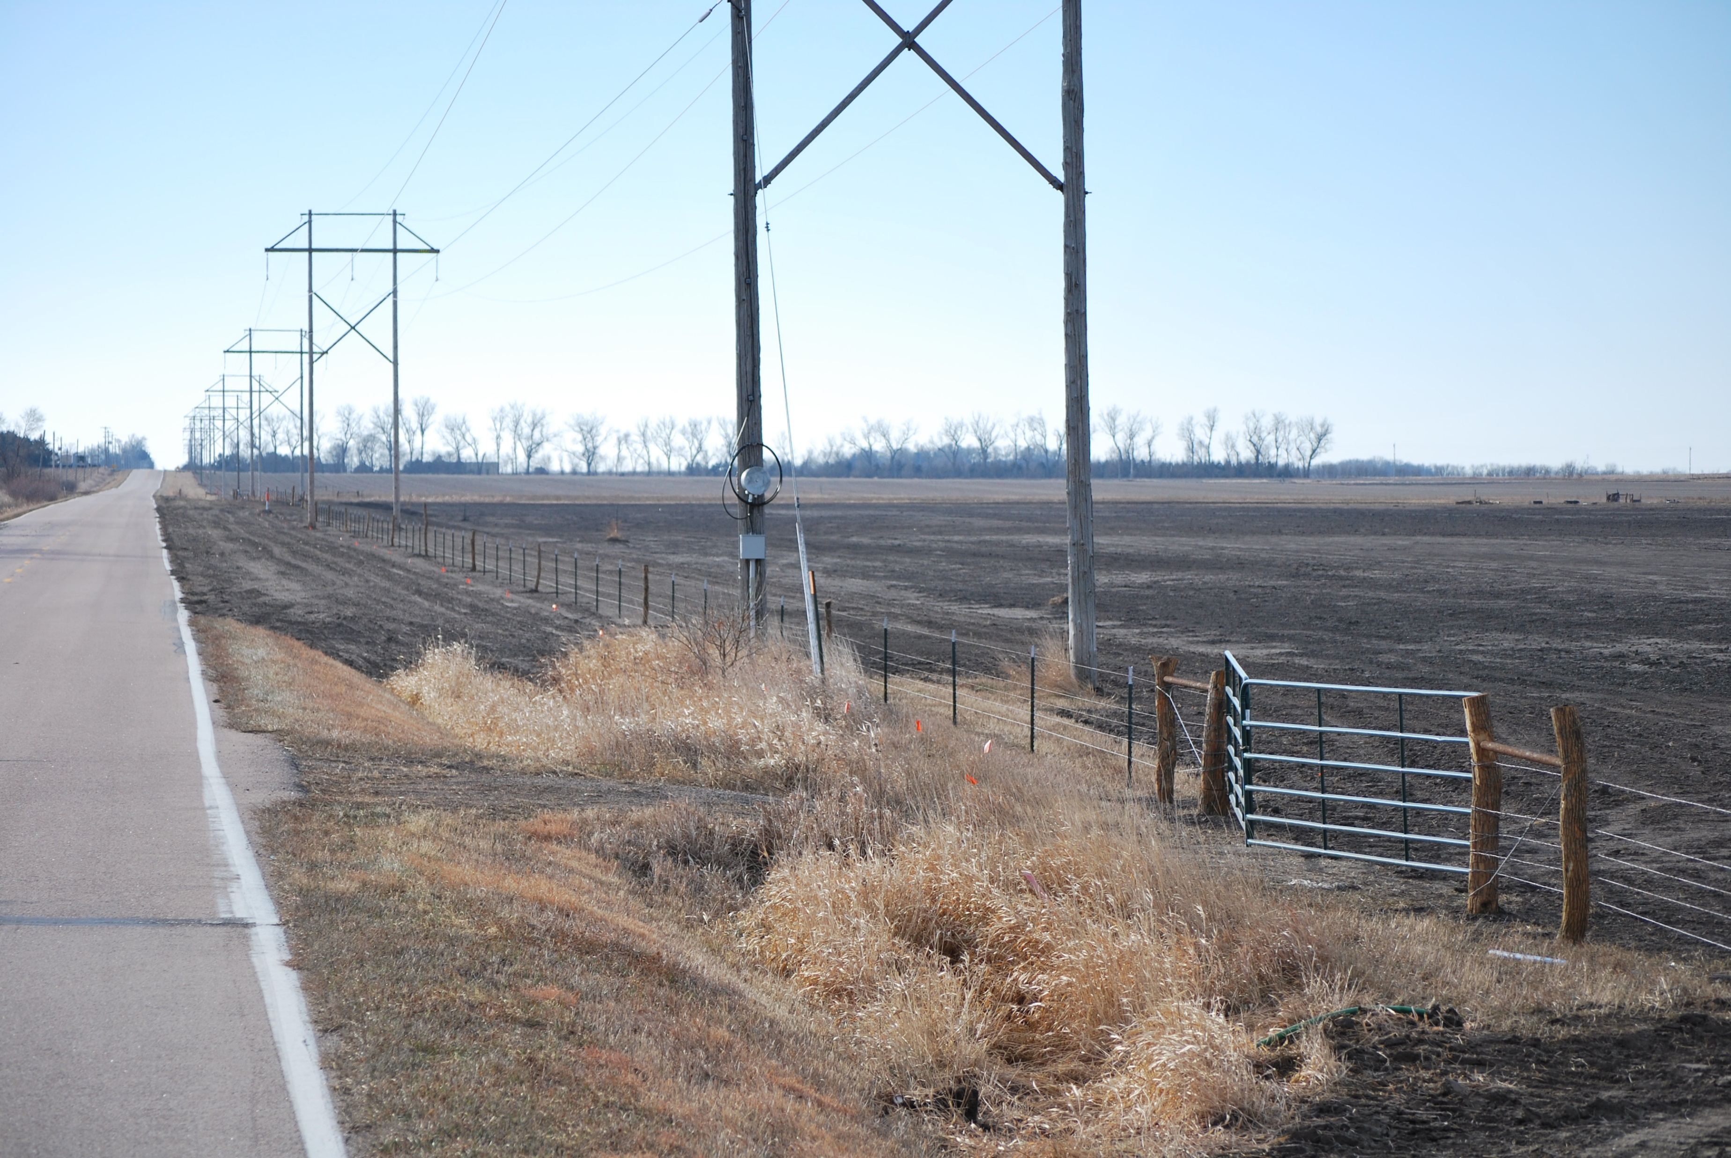
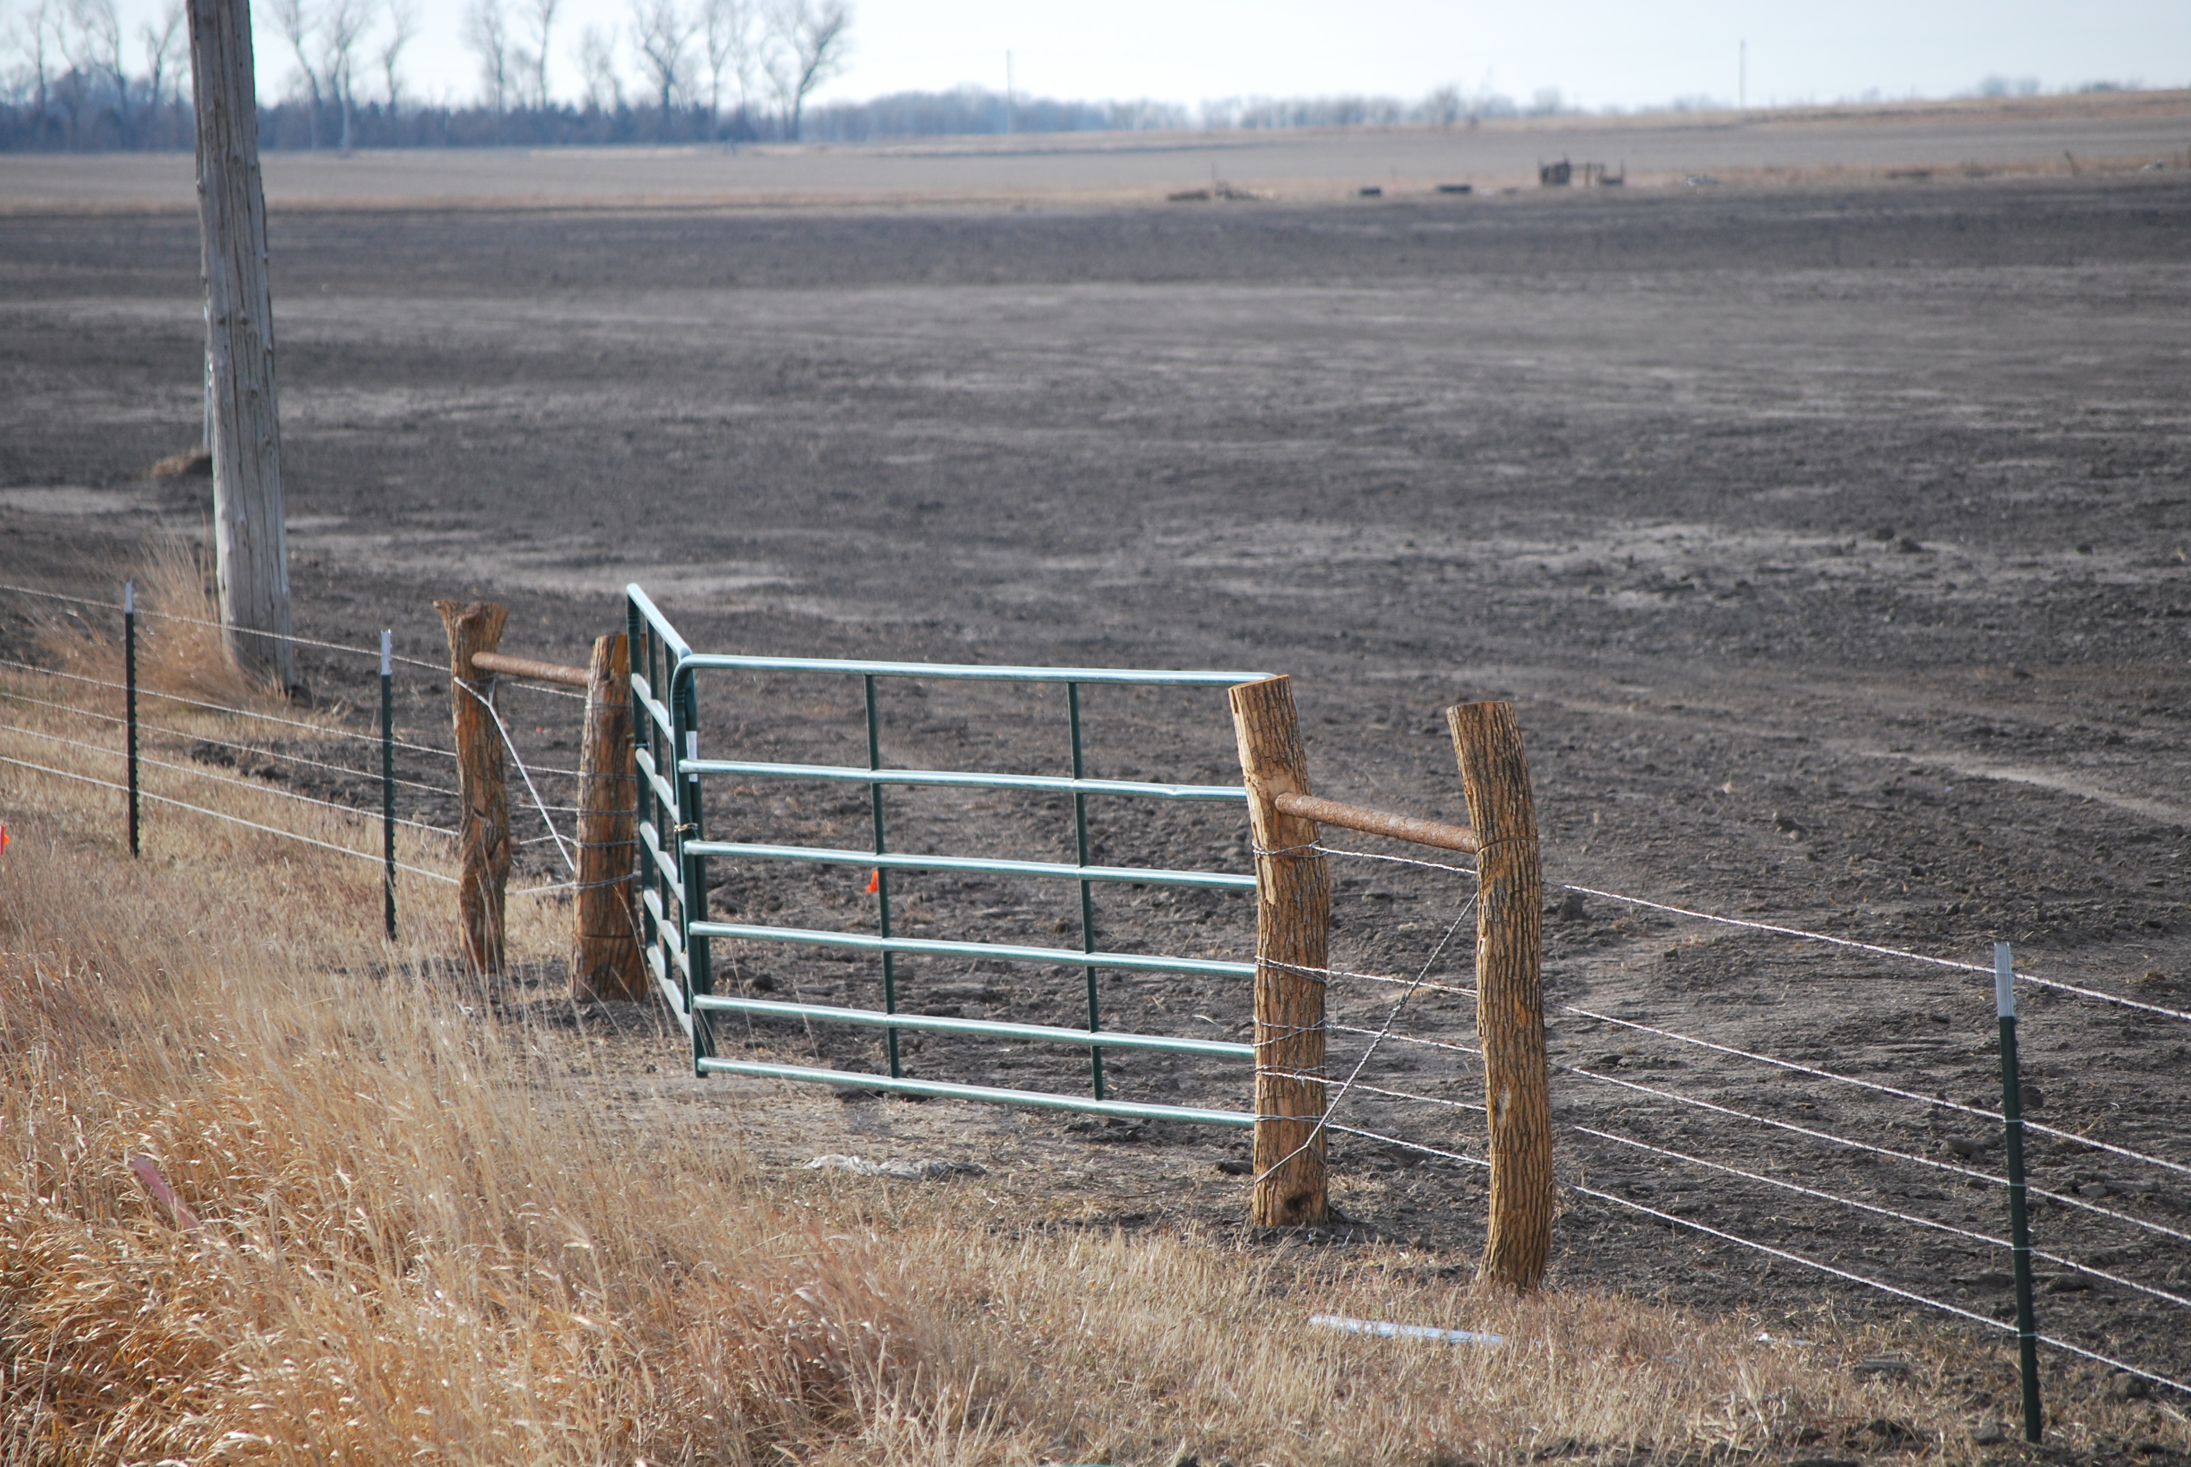
Completed project
58 acres – 18 acres upland, 40 acres wetland

Slide 12
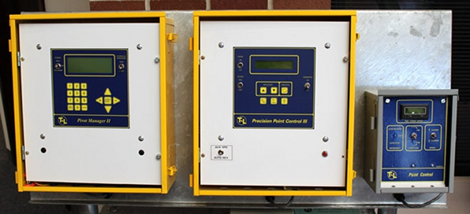
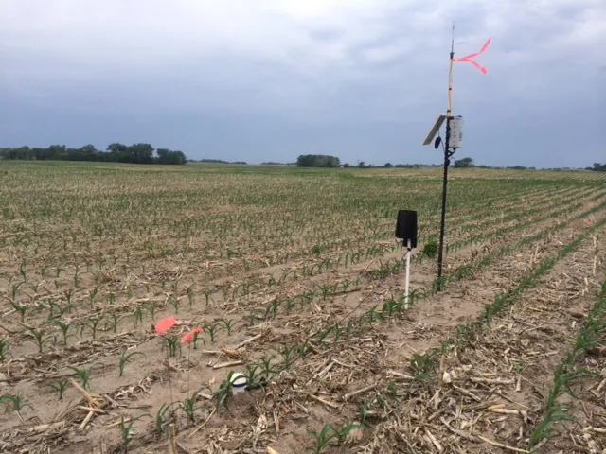
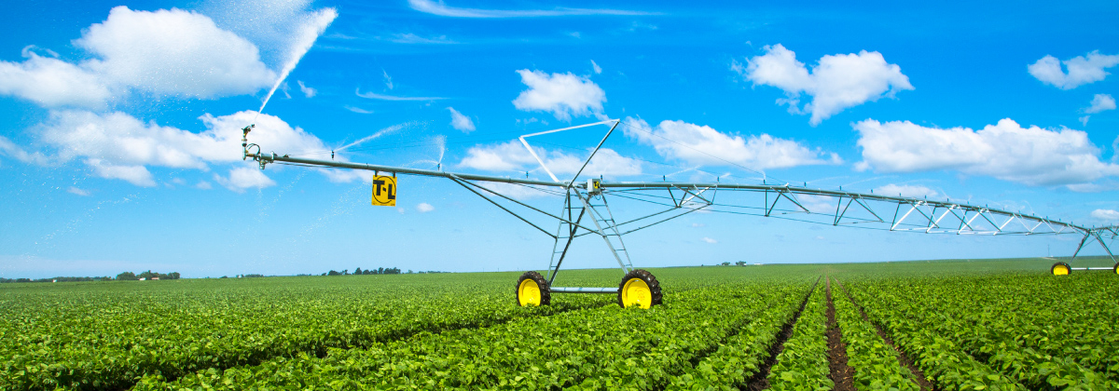
Pivot pipeline, VRI upgrade, sprinklers, moisture probe for existing irrigation system

Slide 13
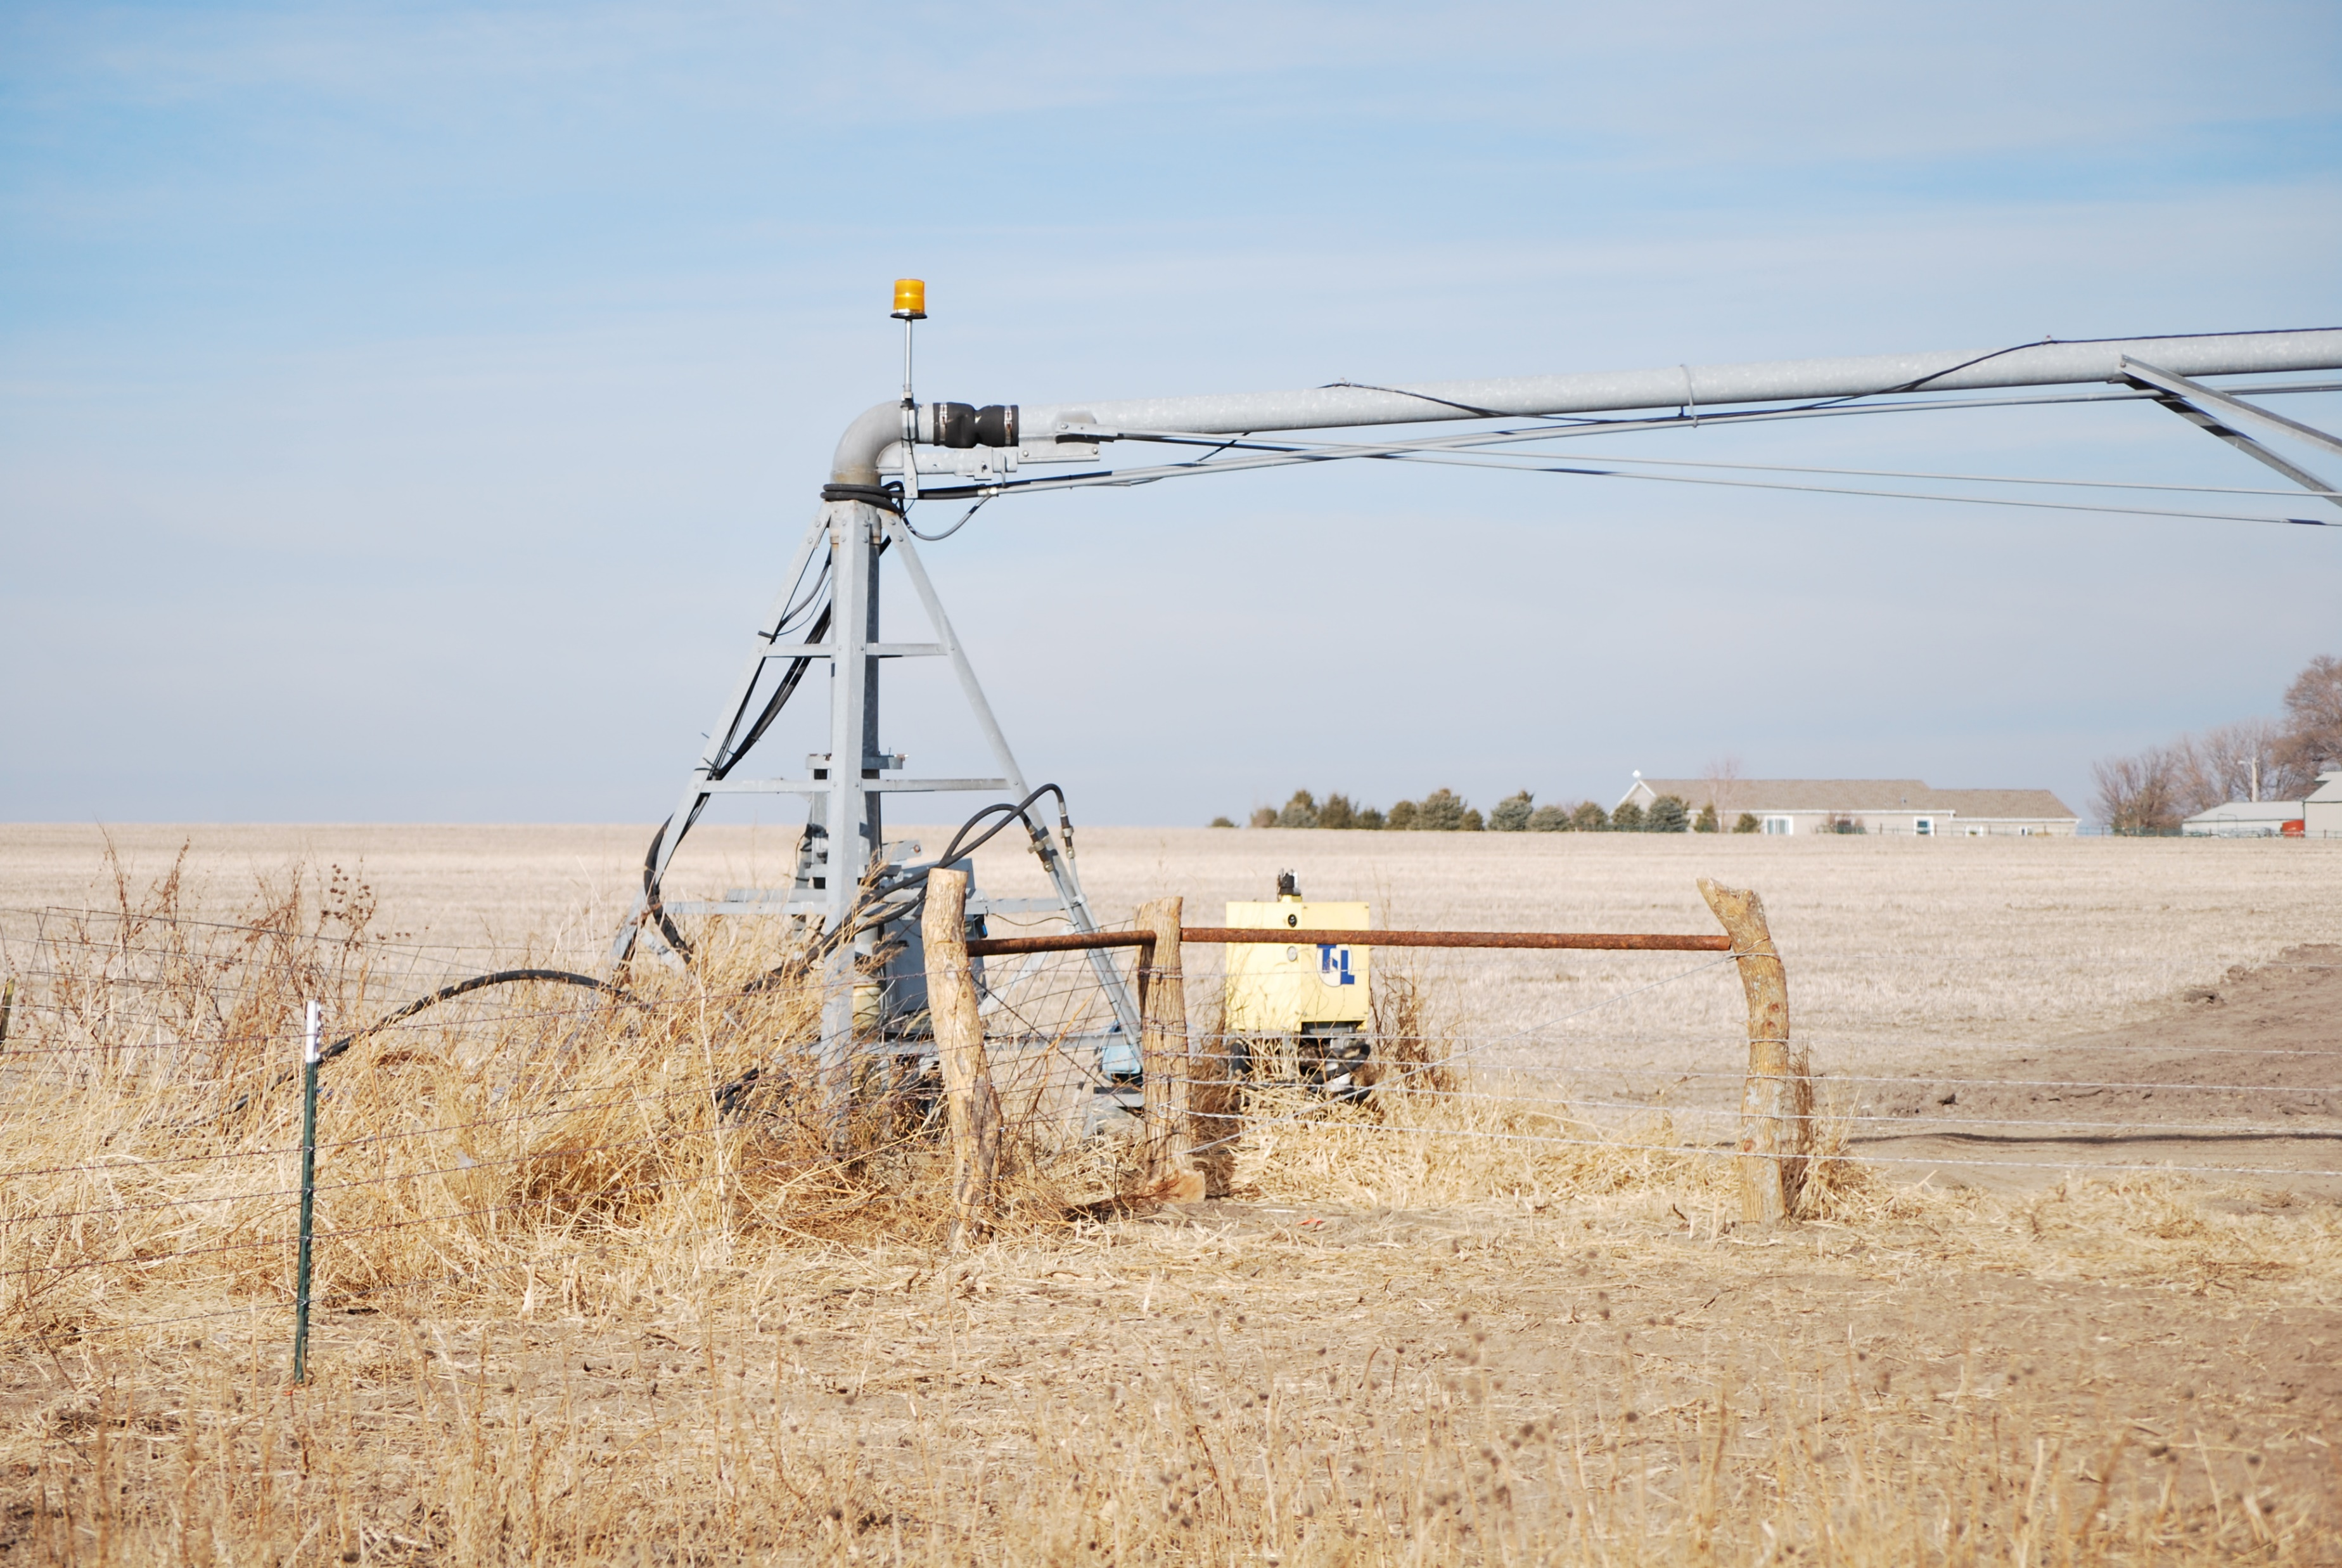
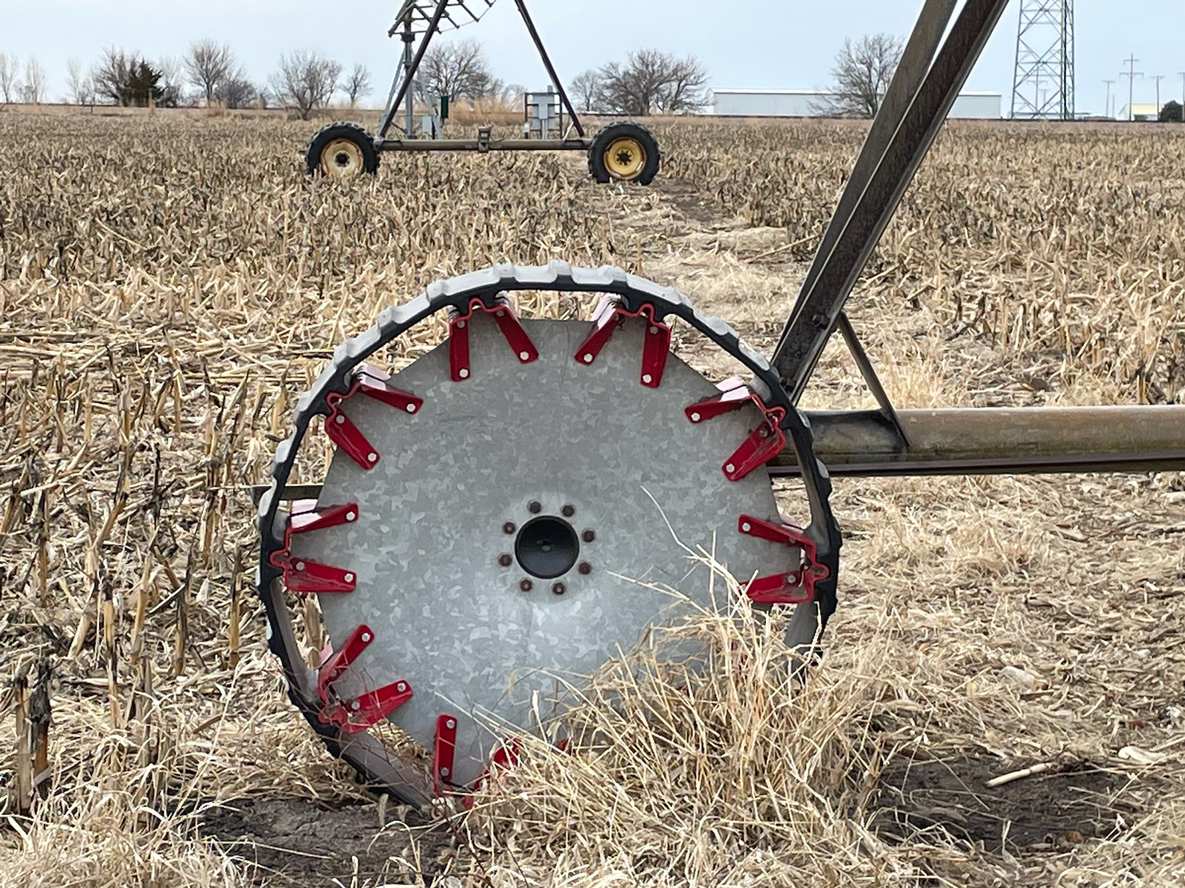
New pivot with VRI technology to replace gravity irrigation
Wheels to navigate wetland

Slide 14
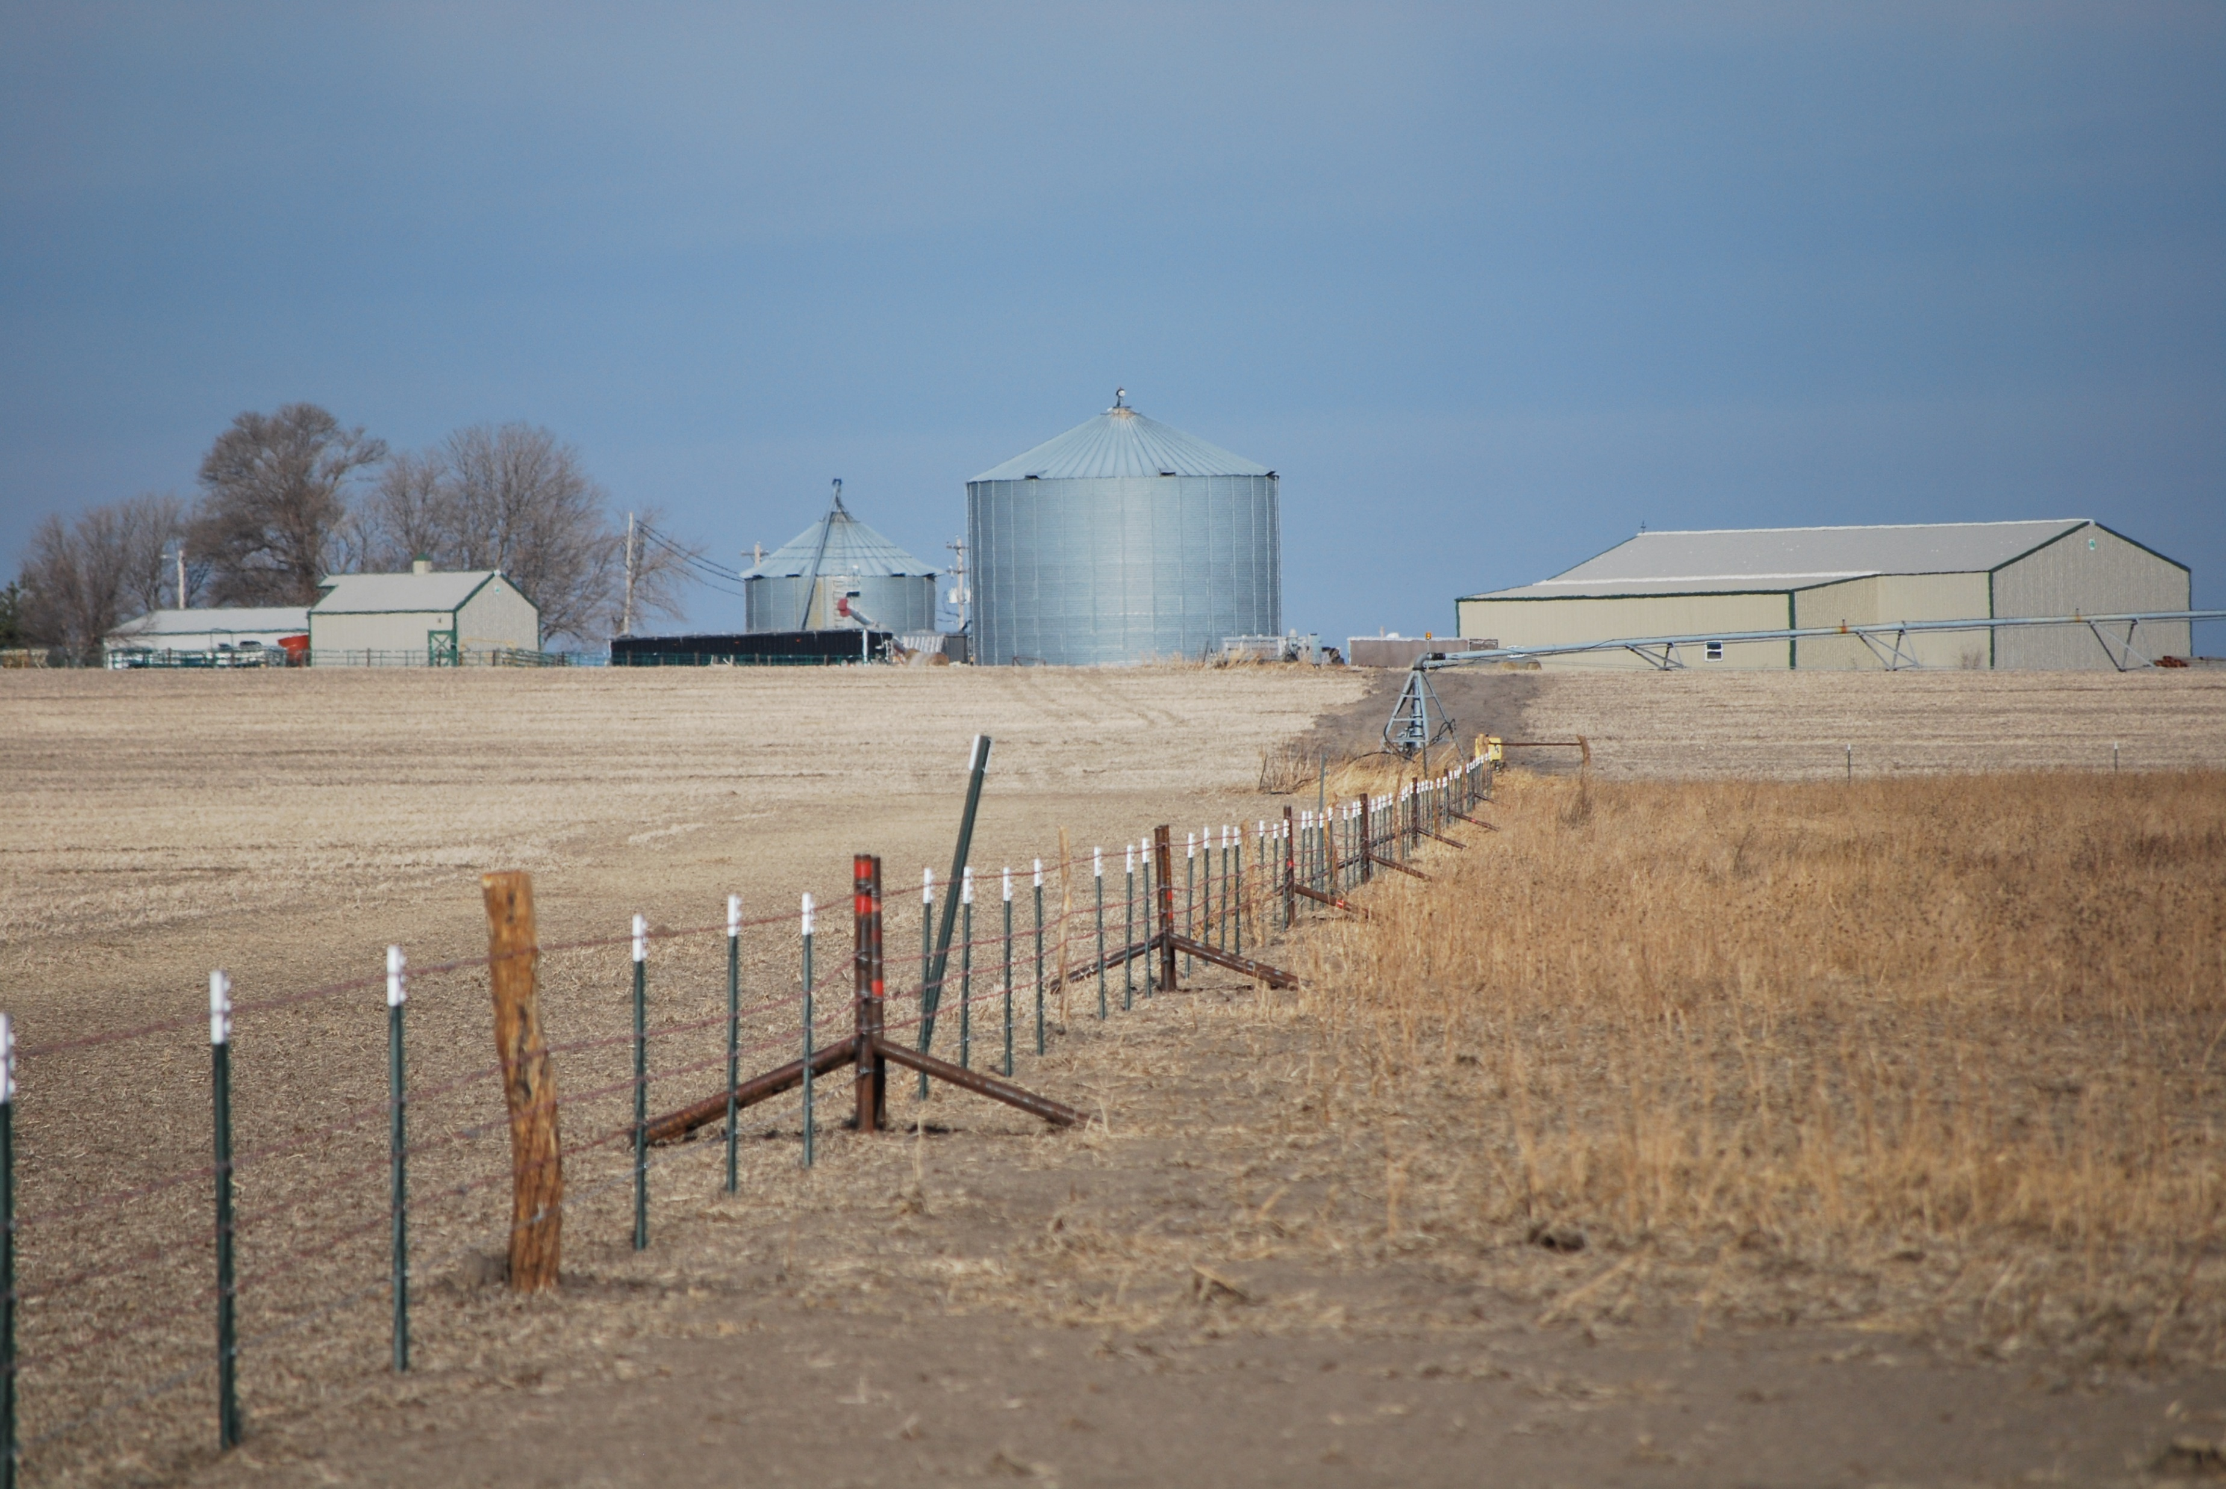
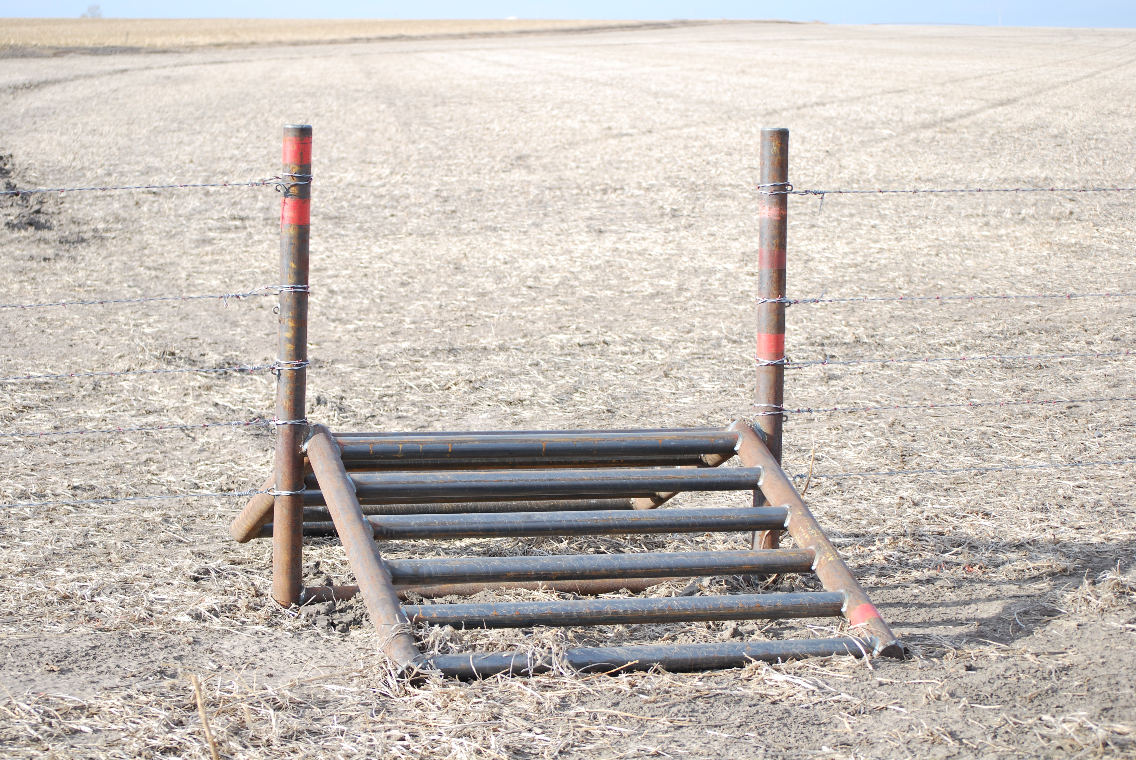
Pivot fence crossing ramps installed

Slide 15
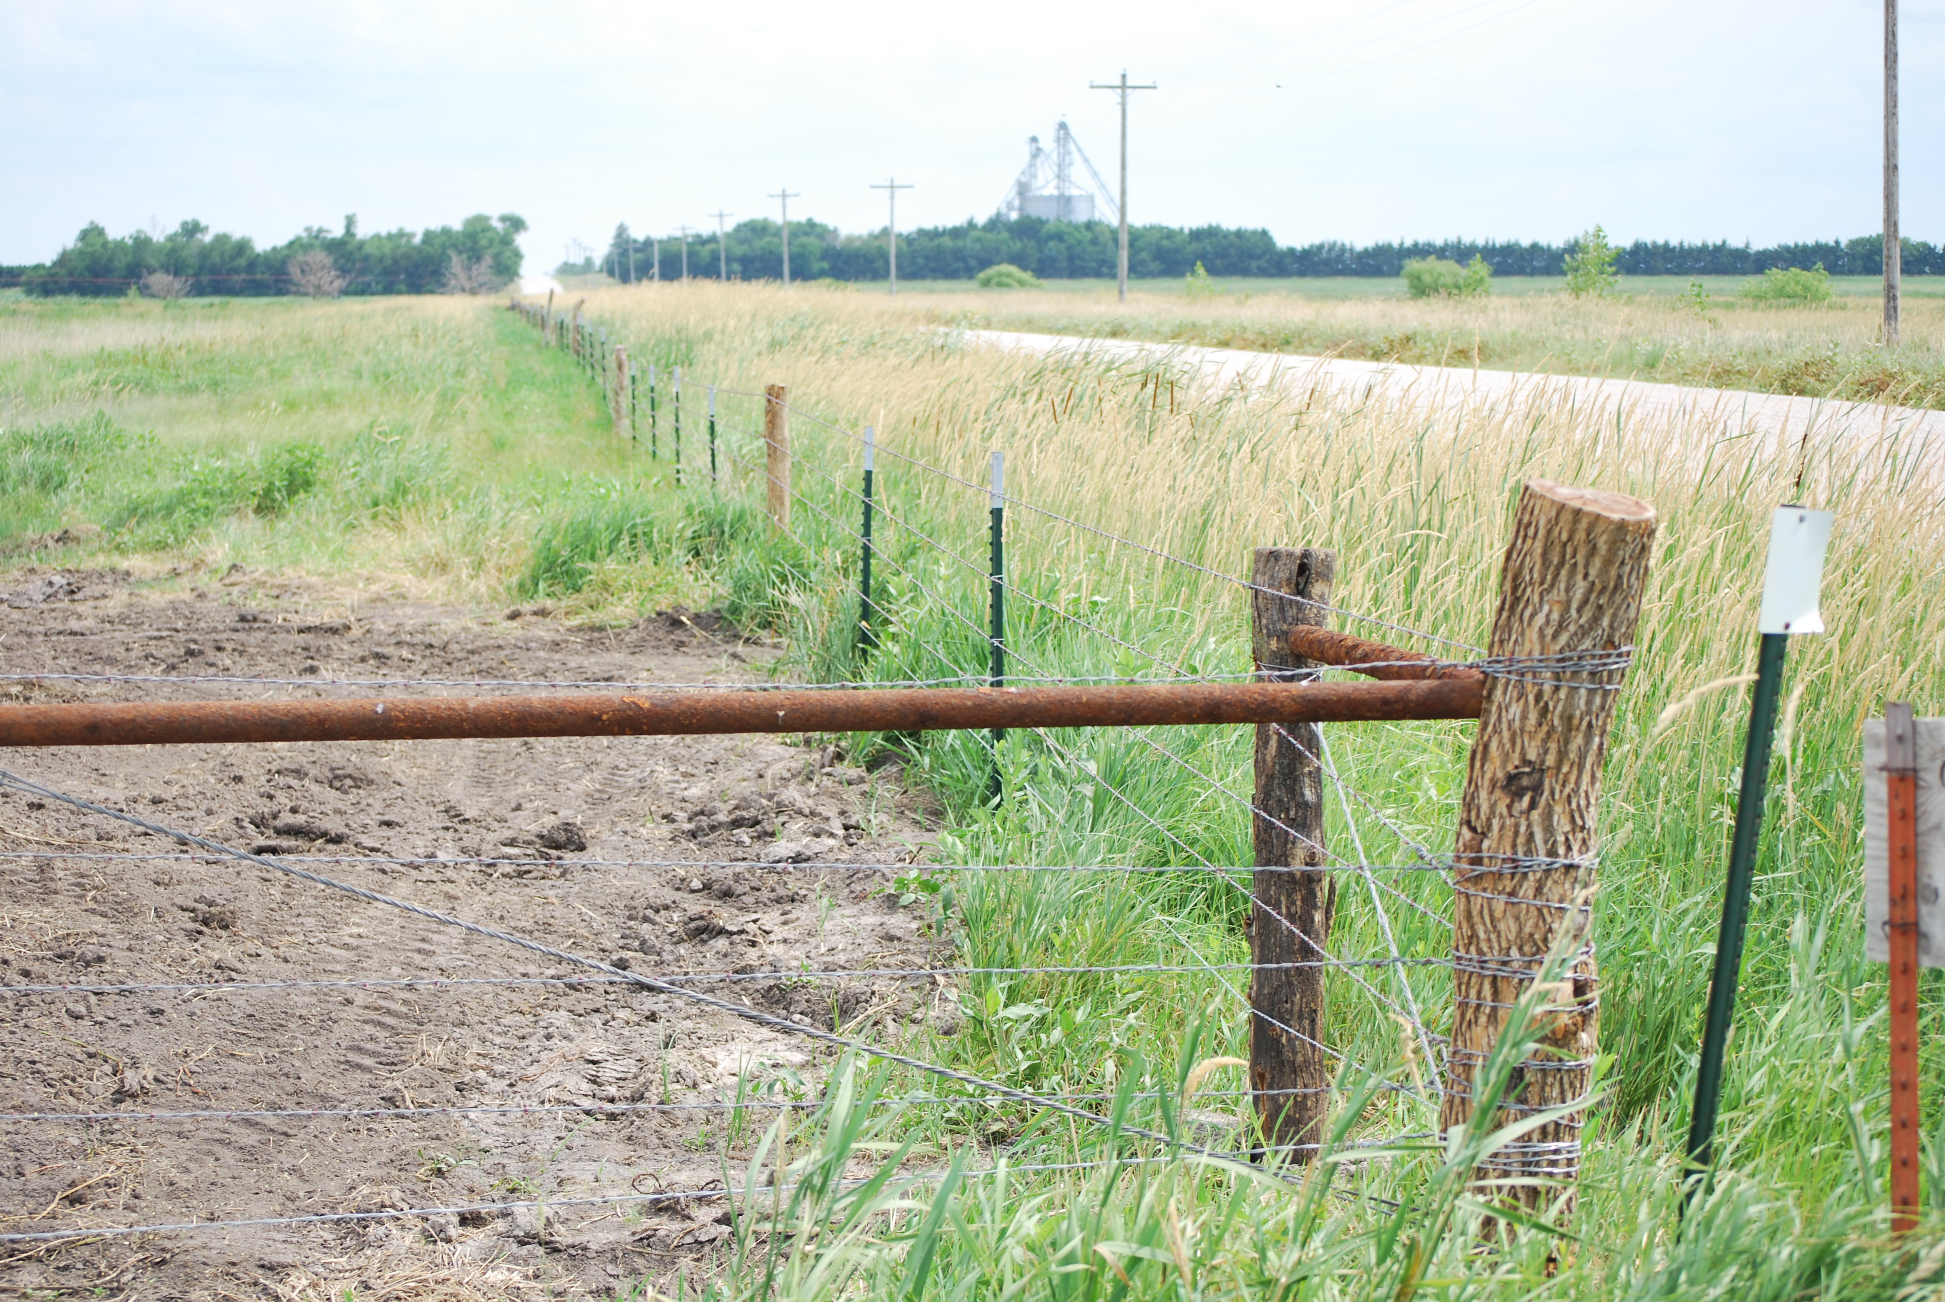
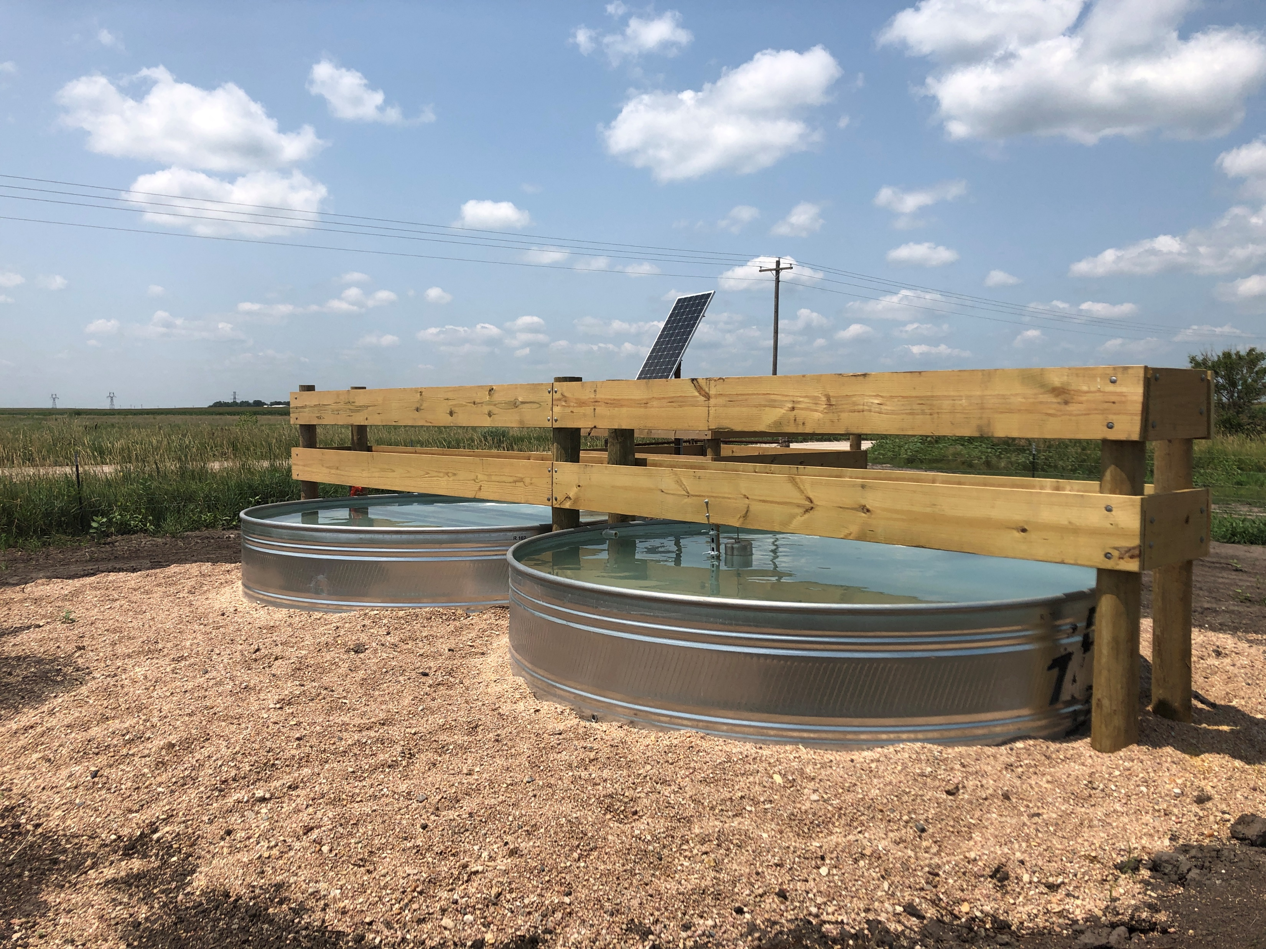
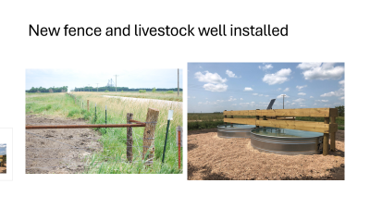
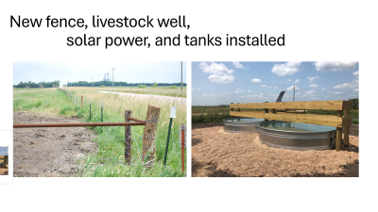
New fence, livestock well, solar power, and tanks installed

Slide 16
Playa Wetland in 2024
Fence with
pivot bridges
Wetland
Upland
areas
New center pivot
irrigation system

Slide 17
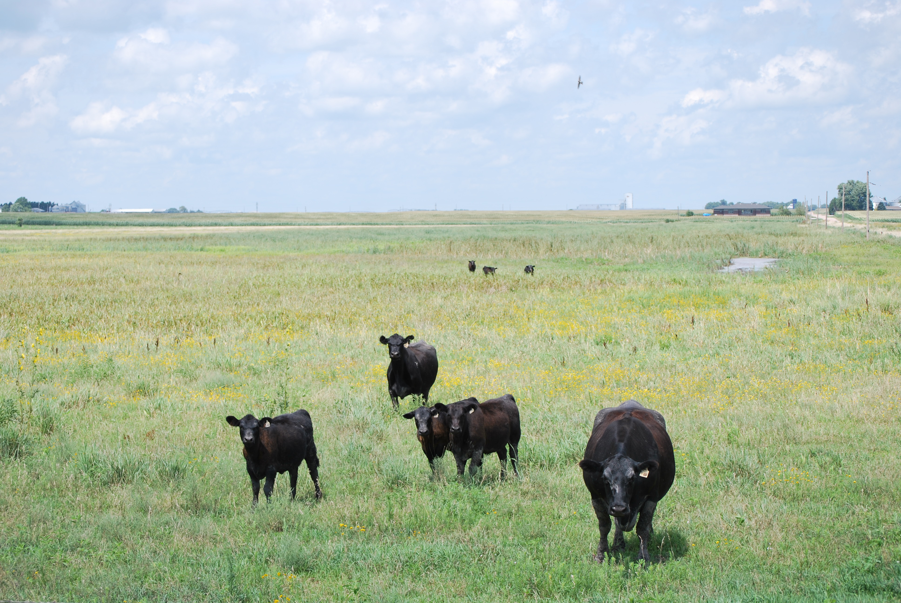
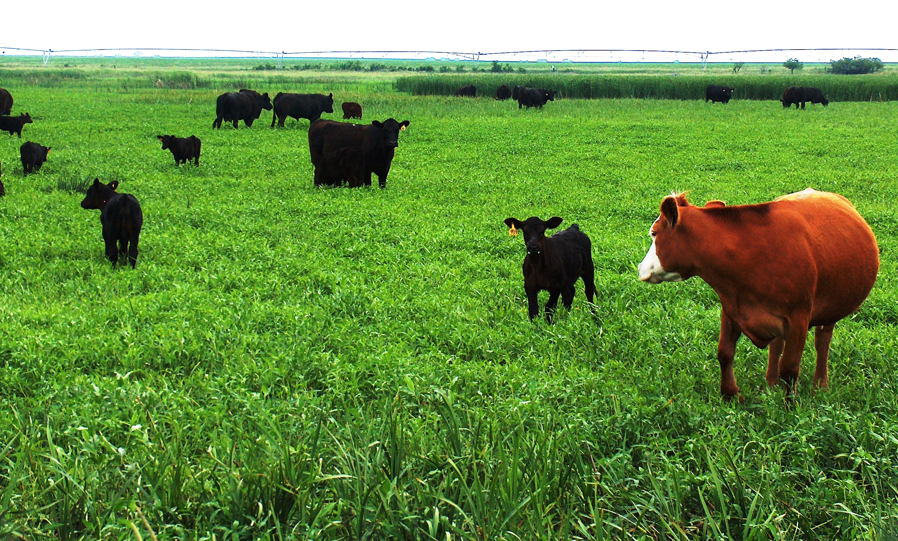
Cattle grazing allowed on easement

Slide 18
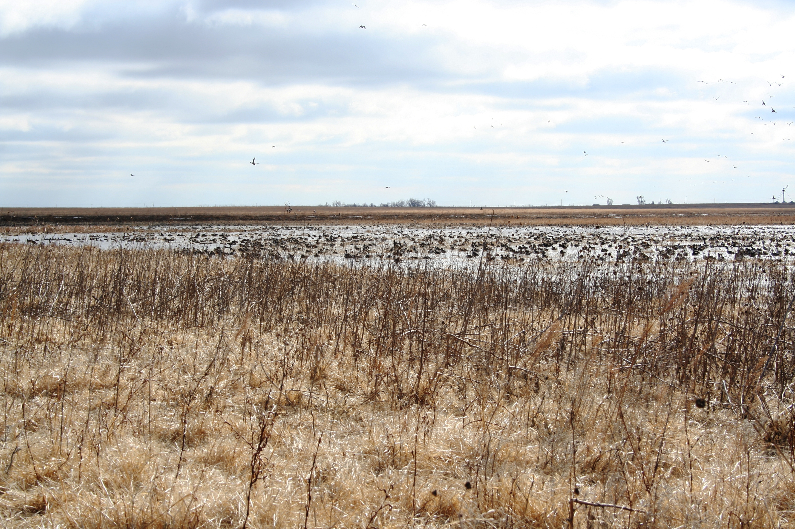
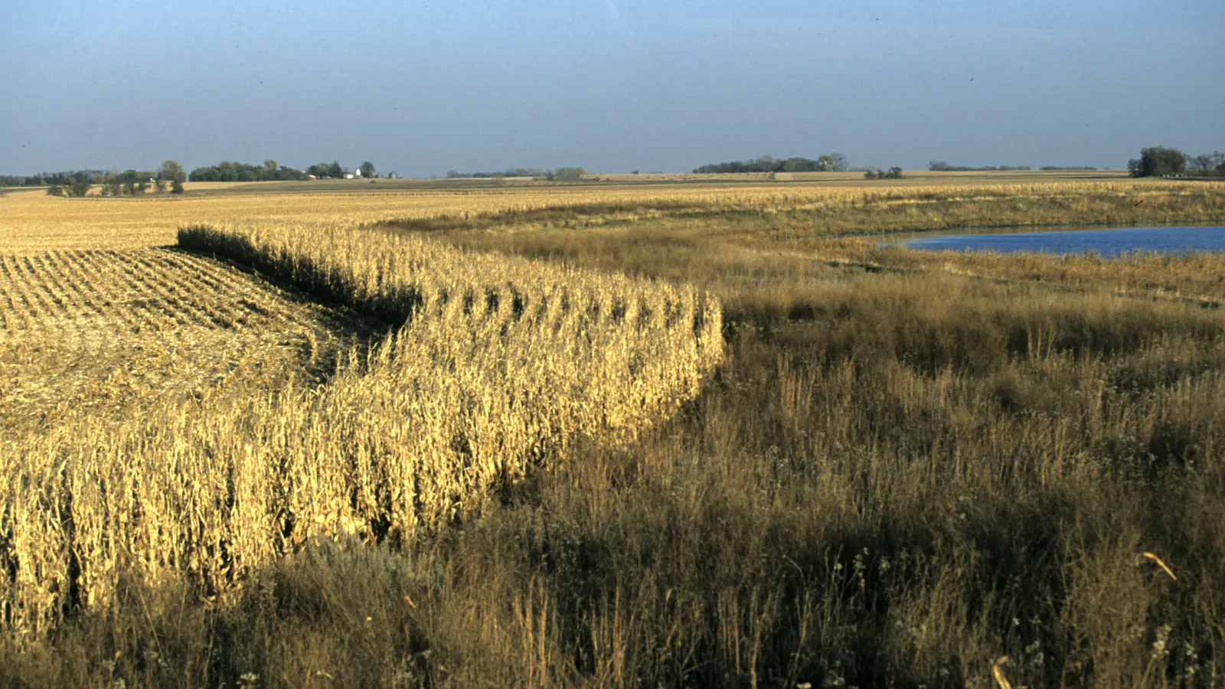
Crops grown to edge of easement
Photo: HUM Images / Universal Images Group via Getty Images

Slide 19
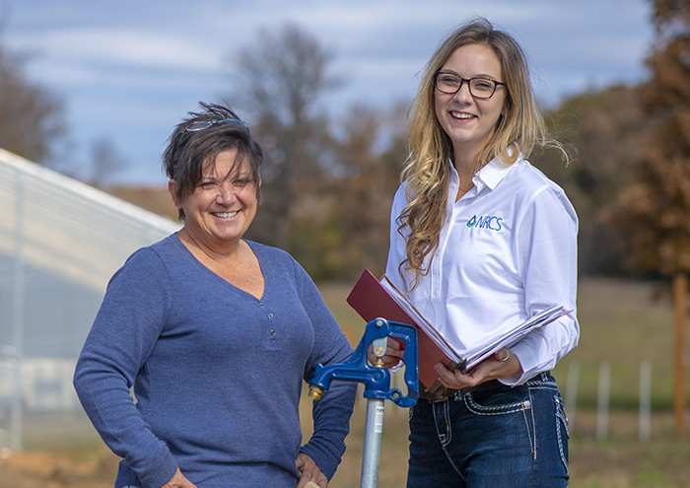
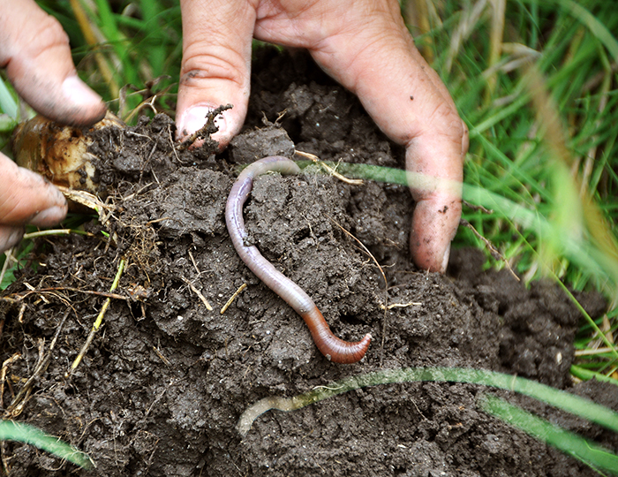

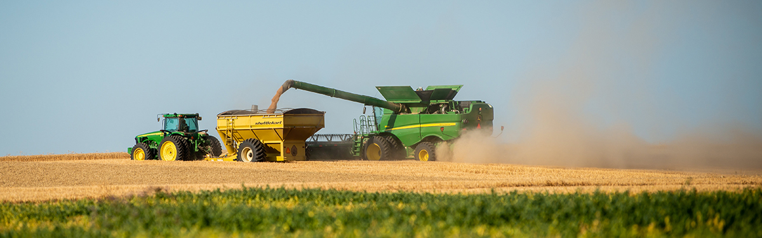
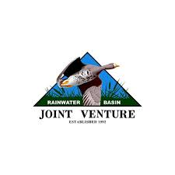

ROI Analysis for a Permanent Wetland Easement
A Financial and Environmental Evaluation

Slide 20
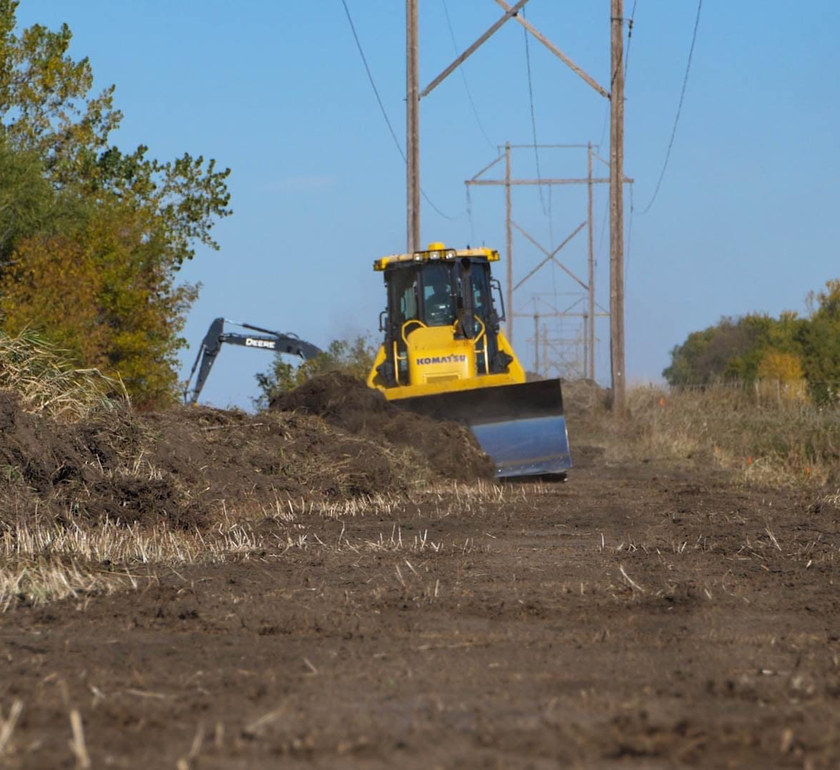
Easements – enrolled in 2021
Landowner one: 13.28 acres, $57,635
Landowner two: 38.42 acres, $143,118

Slide 21
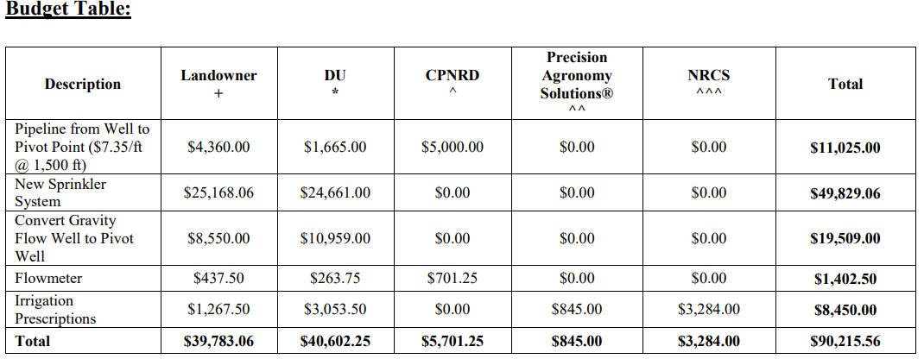
Irrigation equipment improvements
Contribution: 44% 45% 6% 1% 4%

Slide 22


Slide 23
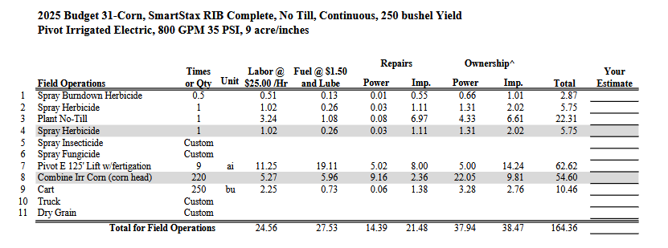
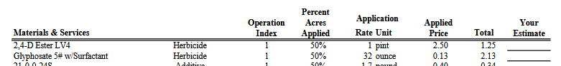
Nebraska Crop Budgets

Slide 24


Slide 25
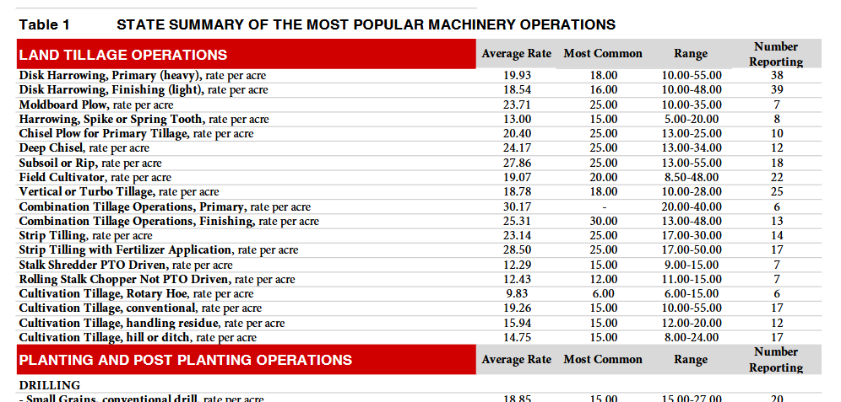
Nebraska Farm Custom Rates

Slide 26
Landowner 1: Financial Overview - Costs

Slide 27
Landowner 2: Financial Overview - Costs

Slide 28
Landowner 1 Yields and Revenue
Corn Price per bu
$
4.32
Soybeans price per bu
$
10.06
Easement Payment
$
57,635.00
2016
2017
2018
2019
2020
2021
2022
2023
Bushels of Corn
15848
12219
15940
15600
15645
Bushels of Soybeans
2774
5306
4305
Total Corn Revenue before 2021
$
190,110.24
Total Soybean Revenue before 2021
$
81,284.80
$271,395.04
(3 years corn, 2 years soybean)
Total Corn Revenue after 2021
$
134,978.40
Total Soybean Revenue after 2021
$
43,308.30
$179,120.31
(2 years corn, 1 year soybean, 1 year grazing)
Grazing($)
833.61

Slide 29
Landowner 2 Yields and Revenue
Corn Price per bu
$
4.32
Soybeans price per bu
$
10.06
Easement payment
$
143,118.00
NE Average Farmland Value (per ac)
$
4,015.00
2015
2016
2017
2018
2019
2020
2021
2022
2023
Bushels of Corn
32380
33215
18216
24703
24656
26361
Bushels of Soybeans
991
9439
7460
7531
Total Corn Revenue before 2021
$
468,780.48
$648,753.88
(3 years corn, 2 years soybean, 1 year both)
Total Soybean Revenue before 2021
$
179,973.40
Total Corn Revenue after 2021
$
220,393.44
(2 years corn, 1 year soybean, 1 year grazing)
Total Soybean Revenue after 2021
$
75,761.86
$299,251.58
Grazing($)
$
3,096.28

Slide 30

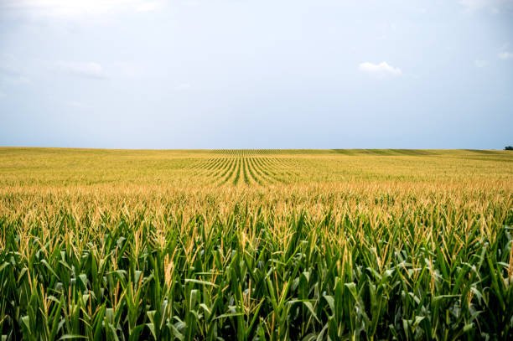
Financial Overview (Pre-Easement Costs & Revenue)
Landowner 1
  Annual Average Operation Cost: $41,072
  Annual Average Revenue: $54,279
  Annual Average Profit: $13,207
  Annual Average ROI: 32%
Landowner 2
  Annual Average Operation Cost: $72,513
  Annual Average Revenue: $108,125
  Annual Average Profit: $35,612
  Annual Average ROI: 49%

Slide 31
Financial Overview (Post-Easement Annual Costs & Revenue)
Landowner 1
  Annual Average Operation Cost: $40,003
  Annual Average Revenue: $60,263
  Annual Average Profit: $20,260
  Annual Average ROI: 51%
Landowner 2
  Annual Average Operation Cost: $69,513
  Annual Average Revenue: $101,815
  Annual Average Profit: $ 32,302
  Annual Average ROI: 46%

Slide 32
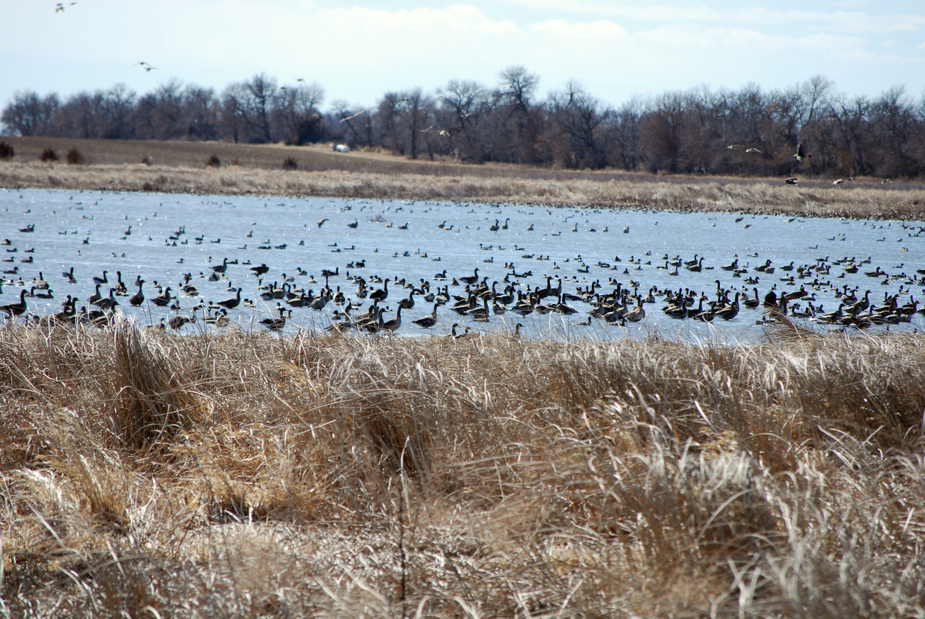
Environmental and Social Benefits
Non-Quantified Benefits:
  Ease of Irrigation
  Potential Improved yields
  Ease of Maintenance
  Flood reduction
  Groundwater Recharge
  Water Quality Improvement
  Cost-Share
    New Pivot & Pivot Upgrades
    Pivot Crossing Ramp
    Livestock well
  Increased Biodiversity

Slide 33
Combined ROI For Both Easements
Because wetlands don’t care about property lines
  Combined Profit Increase: $3,742
  Combined ROI: 48% = 5% increase in ROI
 | Before 2021 |  |  | After 2021
 | Operation cost | Profit | ROI | Operation cost | Profit | ROI
Landowner 1 | $41,071 | $13,208 | 32% | $40,003 | 20,260 | 51%
Landowner 2 | $72,513 | $35,612 | 49% | $69,513 | 32,302 | 46%
Total | $113,585 | $48,820 | 43% | $109,516 | 52,562 | 48%

Slide 34
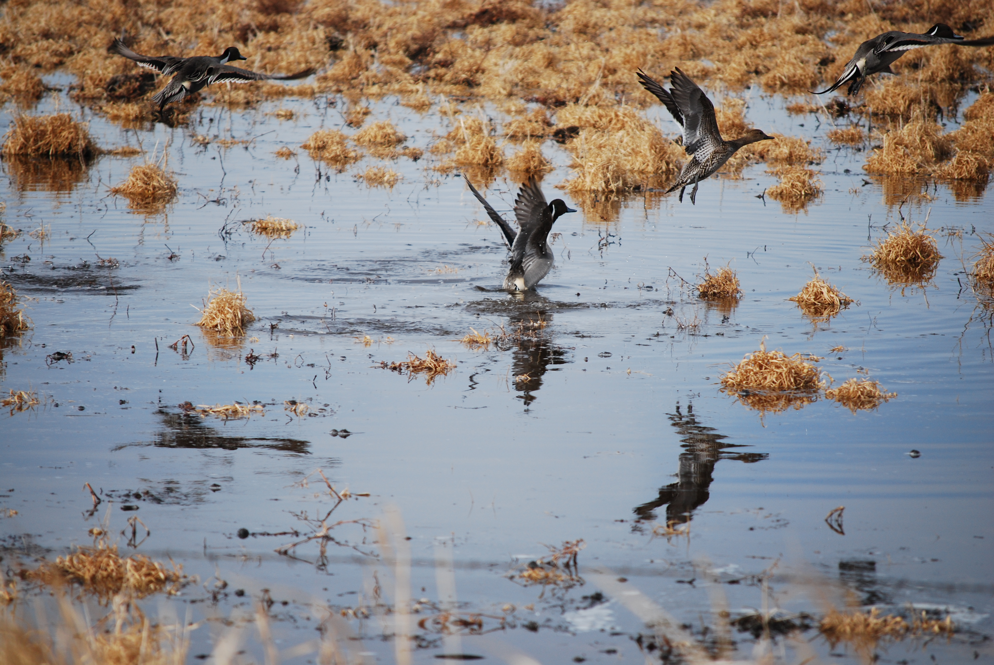
Conclusion
While easements are primarily for conservation, they can also lead to financial benefits for landowners, as shown by the ROI analysis.
Operational cost savings, new revenue streams, improved efficiency, and reductions in risks during flooding events make easements a viable investment opportunity.

Slide 35
Questions?

